Slide 1
Building the Enterprise Cloud with Dynatrace and Red Hat OpenShift
ACM Workshop Toronto
January 9, 2019

Slide 2
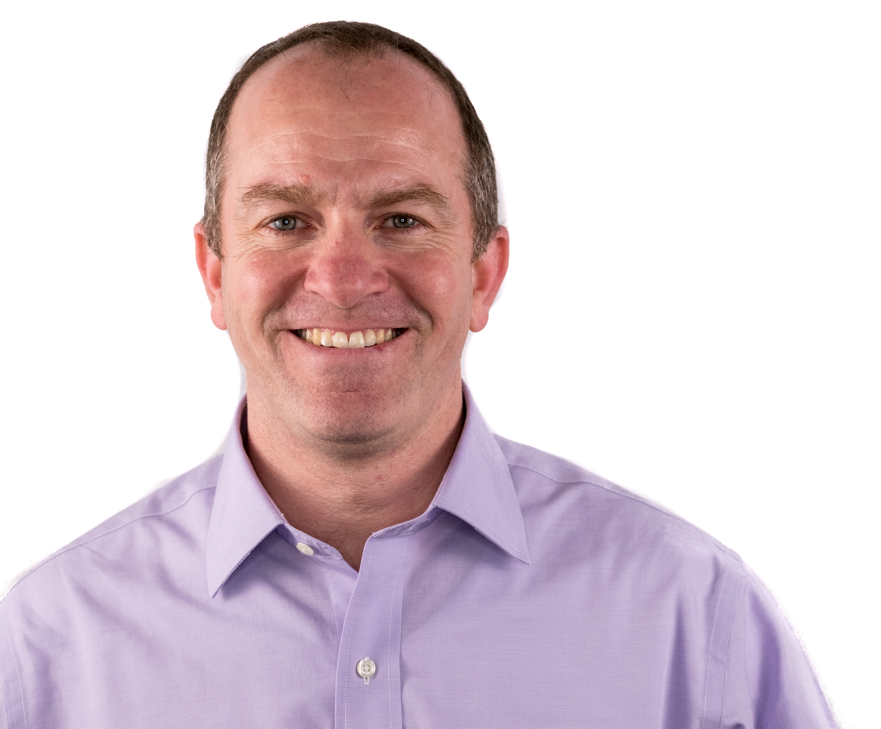
Building the Enterprise Cloud with Dynatrace and Red Hat OpenShift
January 9, 2019
Peter Hack
Sr. Tech Evangelist
Dynatrace Innovation Lab
@hackatdt

Slide 3
Agenda
Introduction
Sockshop Application
Architecture
Prerequisites Setup
Workshops
Monitoring as a Service
Building Environment Zero with OpenShift and Jenkins
Performance as a Self-Service
Runbook Automation with Ansible

Slide 4
Introduction

Slide 5
https://www.intersport-wohlleben.de/magazin/kapitel-4-from-zero-to-hero-mit-howie-von-0-auf-42-2/

Slide 6
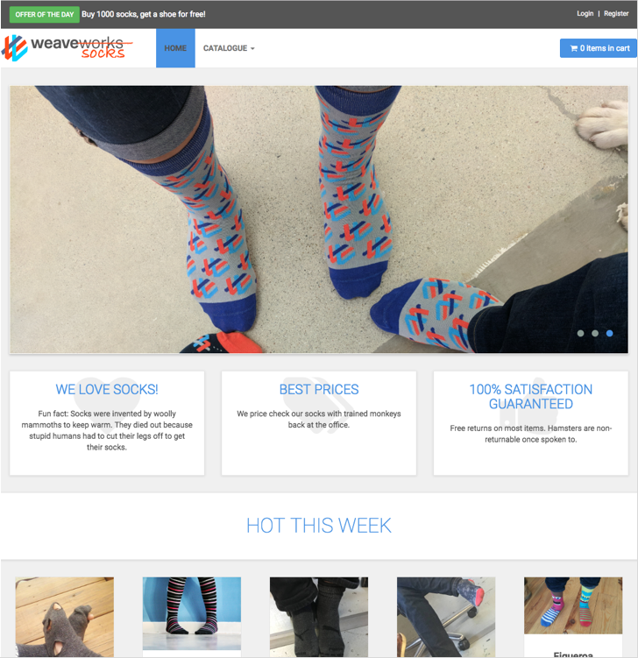
Sockshop Application
http://socks.weave.works
OpenSource microservice app
Polyglot
Java
Go
Node.js
RabbitMQ
Database (Mongo, MySQL)

Slide 7
Sockshop Architecture

Slide 8
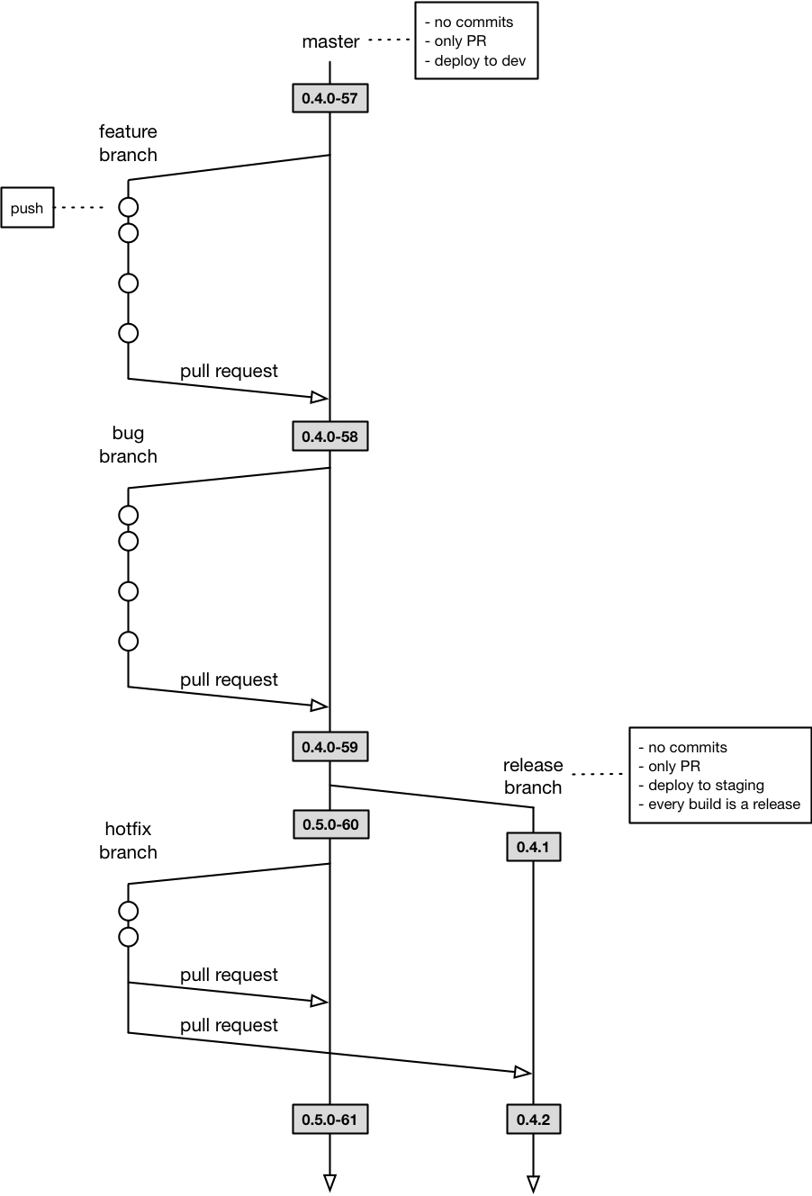
Workflow I

Slide 9
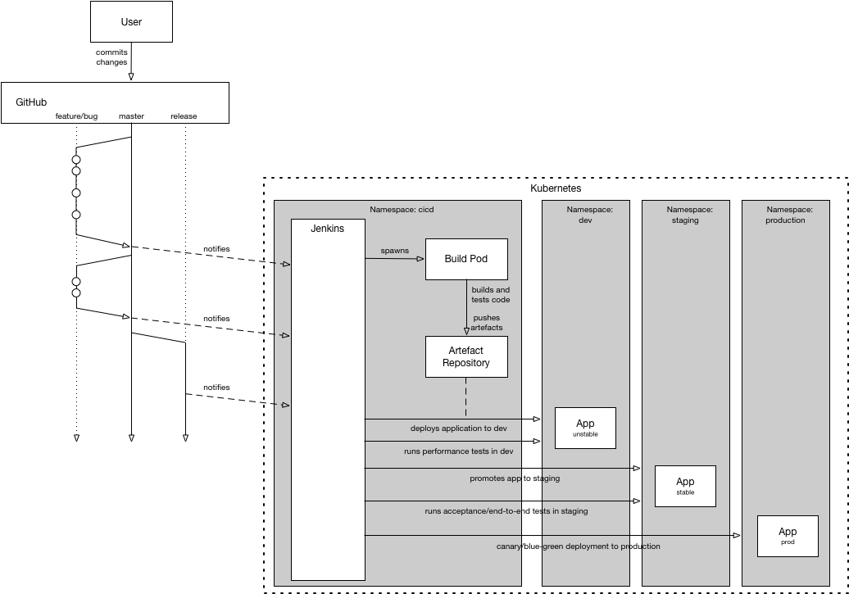
Workflow II

Slide 10
Prerequisites You must have the following to continue
Have a laptop with an SSH client (SmartTTY or Putty)
Have their own Dynatrace SaaS Account. Don’t have one? Sign up here:
http://bit.ly/dtsaastrial
Must have a github account. Don't have one? Sign up here:
https://github.com/join
Basic experience with GIT, Dynatrace and OpenShift Container Platform.
A modern browser (Chrome, Firefox) and access to the public internet

Slide 11






Workshop Setup
GitHub
Participant with Laptop
Bastion Host
OpenShift cluster

Slide 12
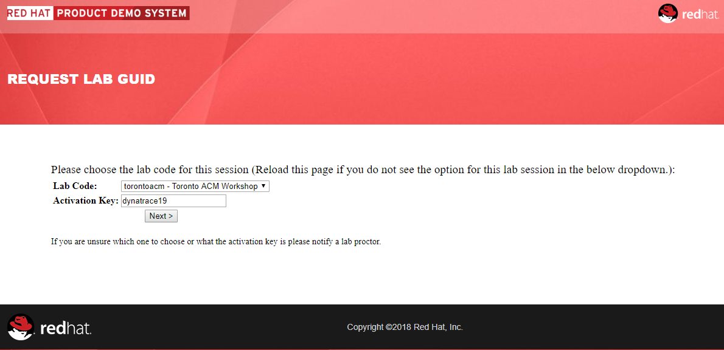
http://bit.ly/torontoacm
Setting up your Openshift Cluster
Log into your Cluster
Key: dynatrace19
Select Next

Slide 13
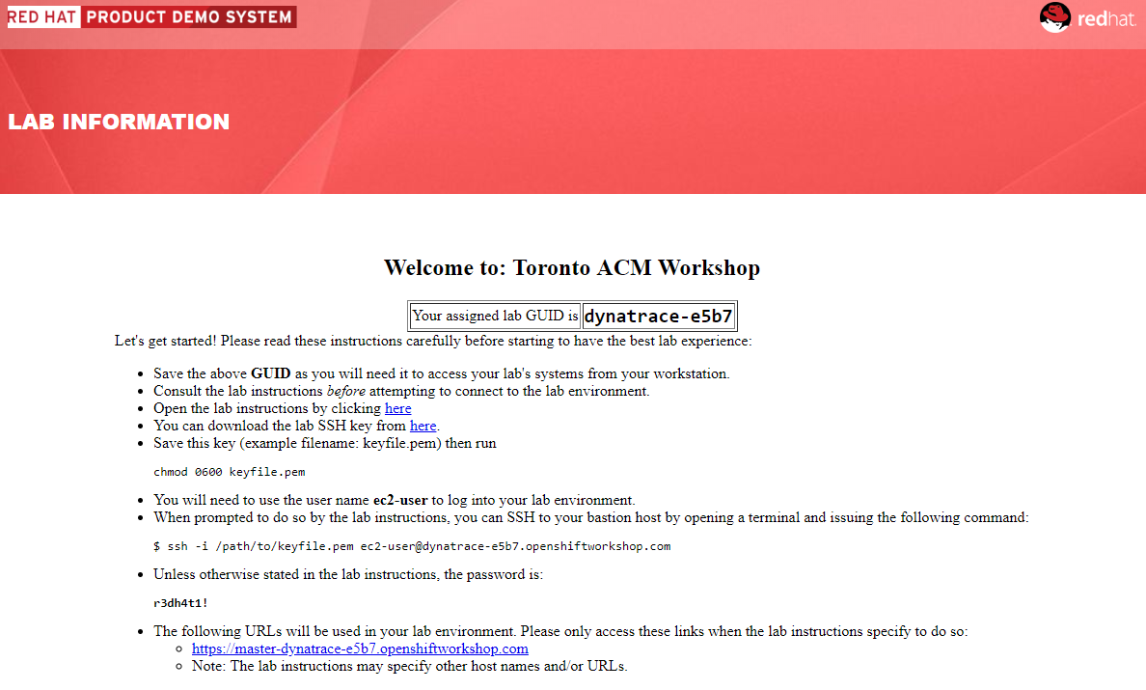
http://bit.ly/torontoacm
Setting up your Openshift Cluster
Download .pem file
Open SSH client
SSH to bastion host
Open Browser
Connect to OpenShift console
User: opentlc-mgr
Pass: r3dh4t1!

Slide 14
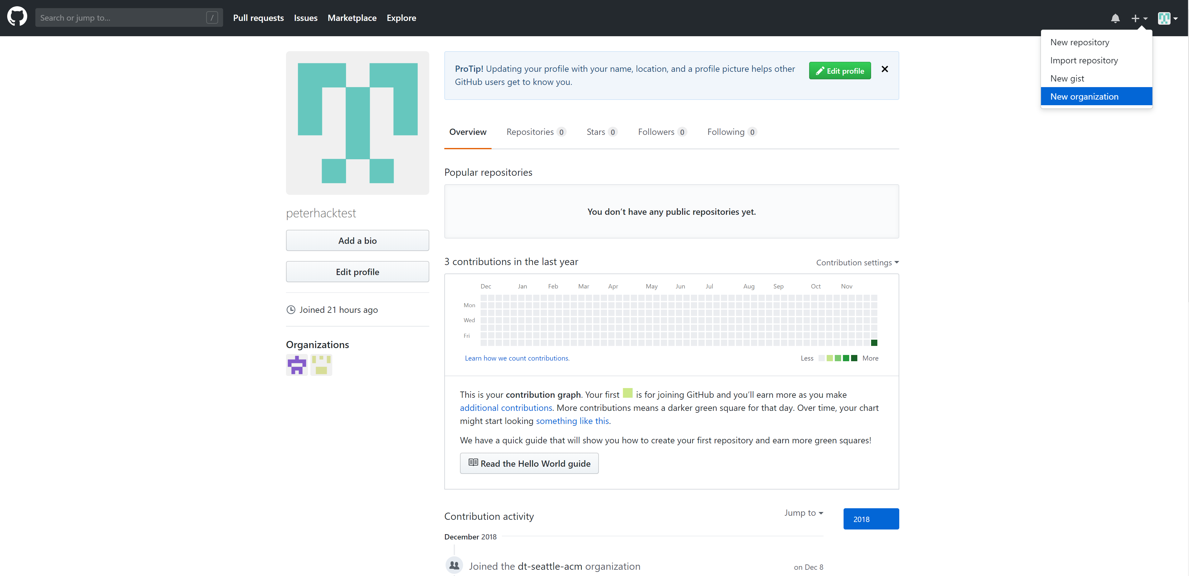
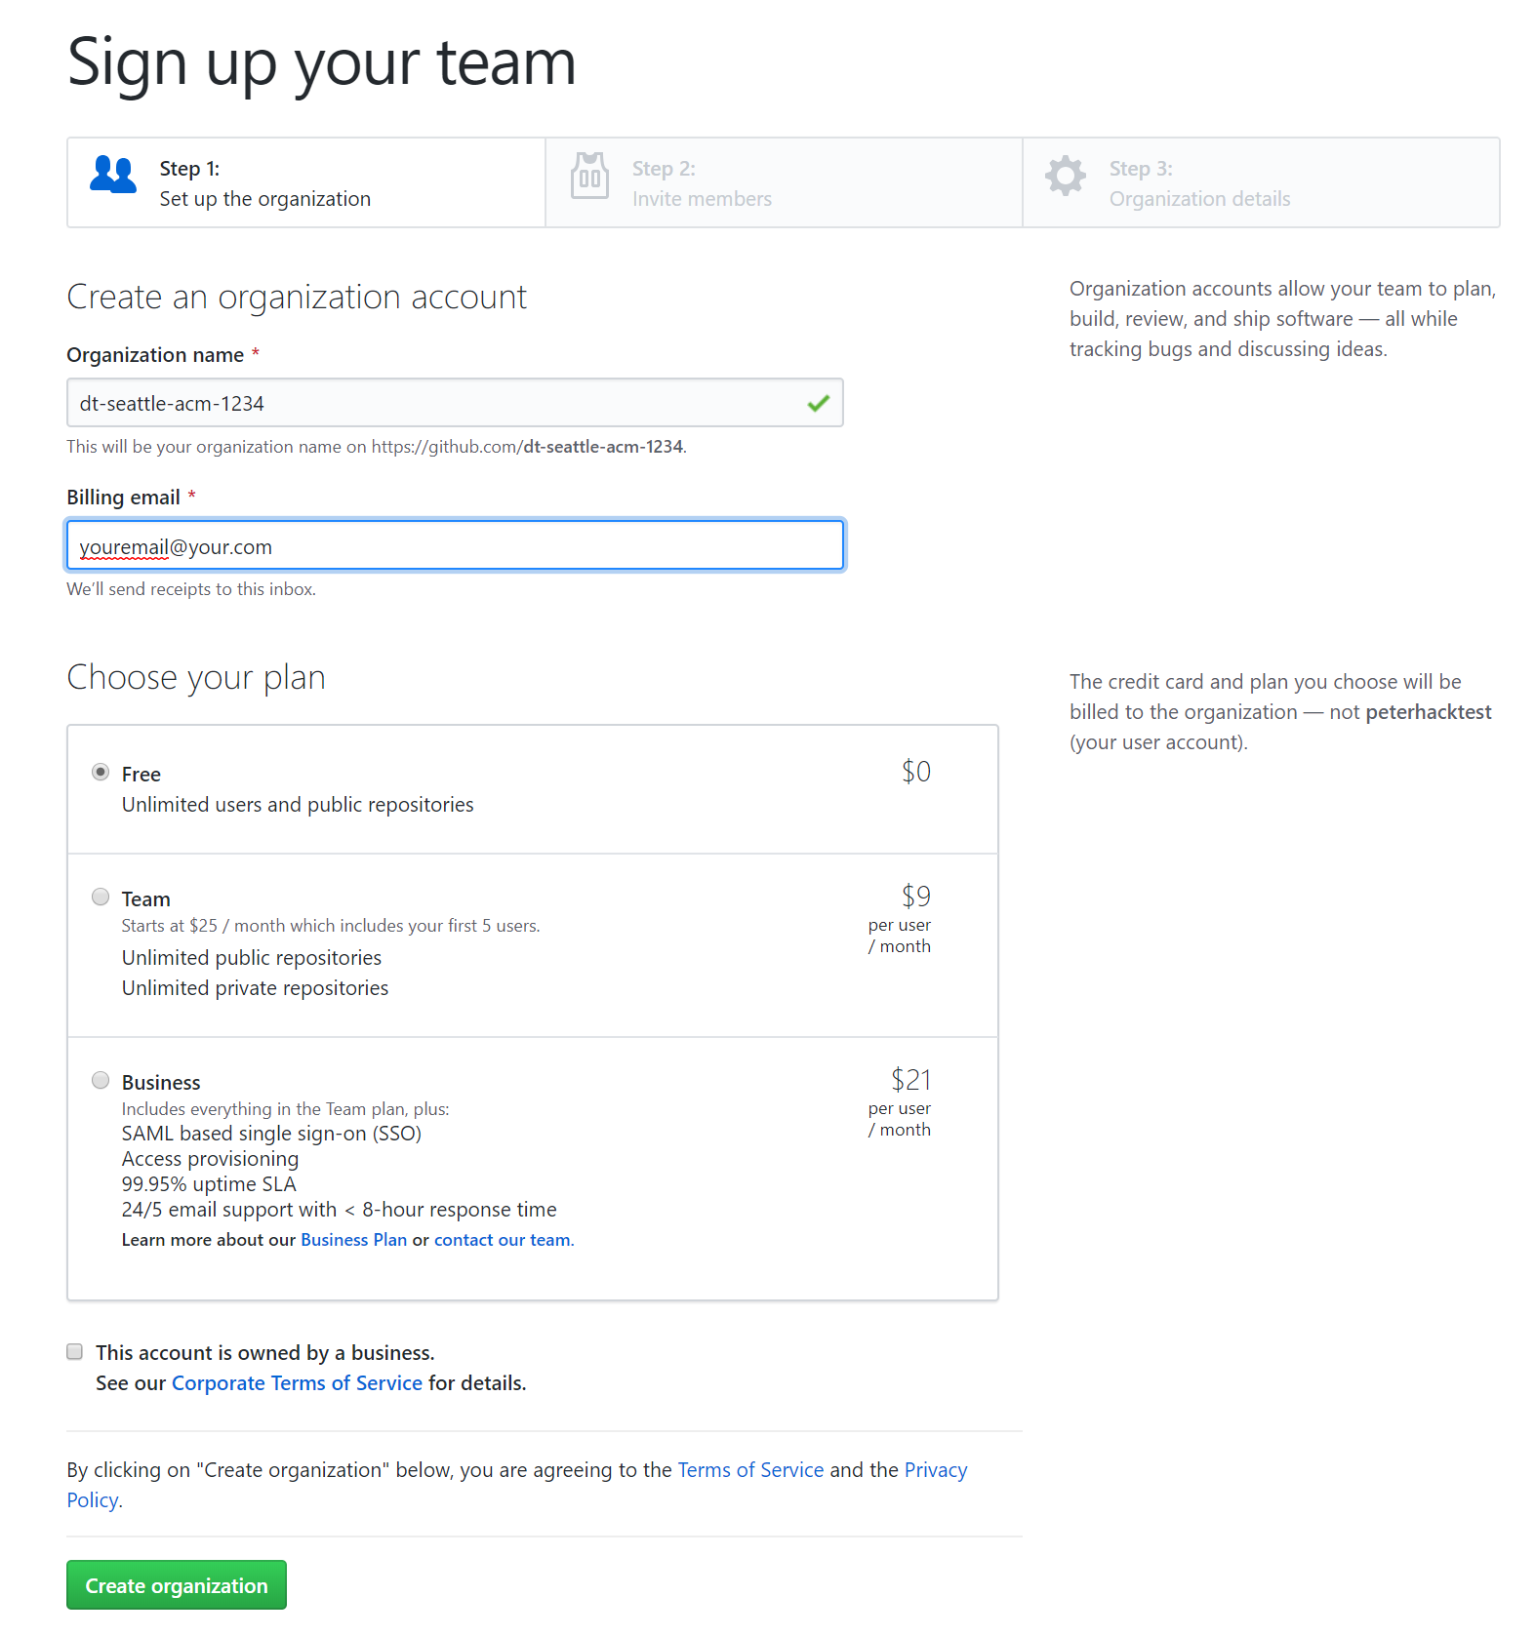
Create a new Git Organization
Github prerequisite
Create a new git organization
name it: dt-toronto-acm-#### (where #### = GUID)
Add your email
Create organization -> continue -> skip
1
2
3
4

Slide 15
Bastion setup
[ec2-user@bastion]$ git clone https://github.com/peterhack/util.git
[ec2-user@bastion]$ ~/util/bastion_setup.sh
Enter credentials when prompted:
Please enter your Github Username: <YOUR GITHUB USERNAME>
Please enter your Github Organization: <YOUR GITHUB ORGANIZATION>
Please log into your OpenShift cluster
Authentication required for https://master:443 (openshift)
Username: opentlc-mgr
Password: r3dh4t1!
Please use these credentials for OpenShift

Slide 16
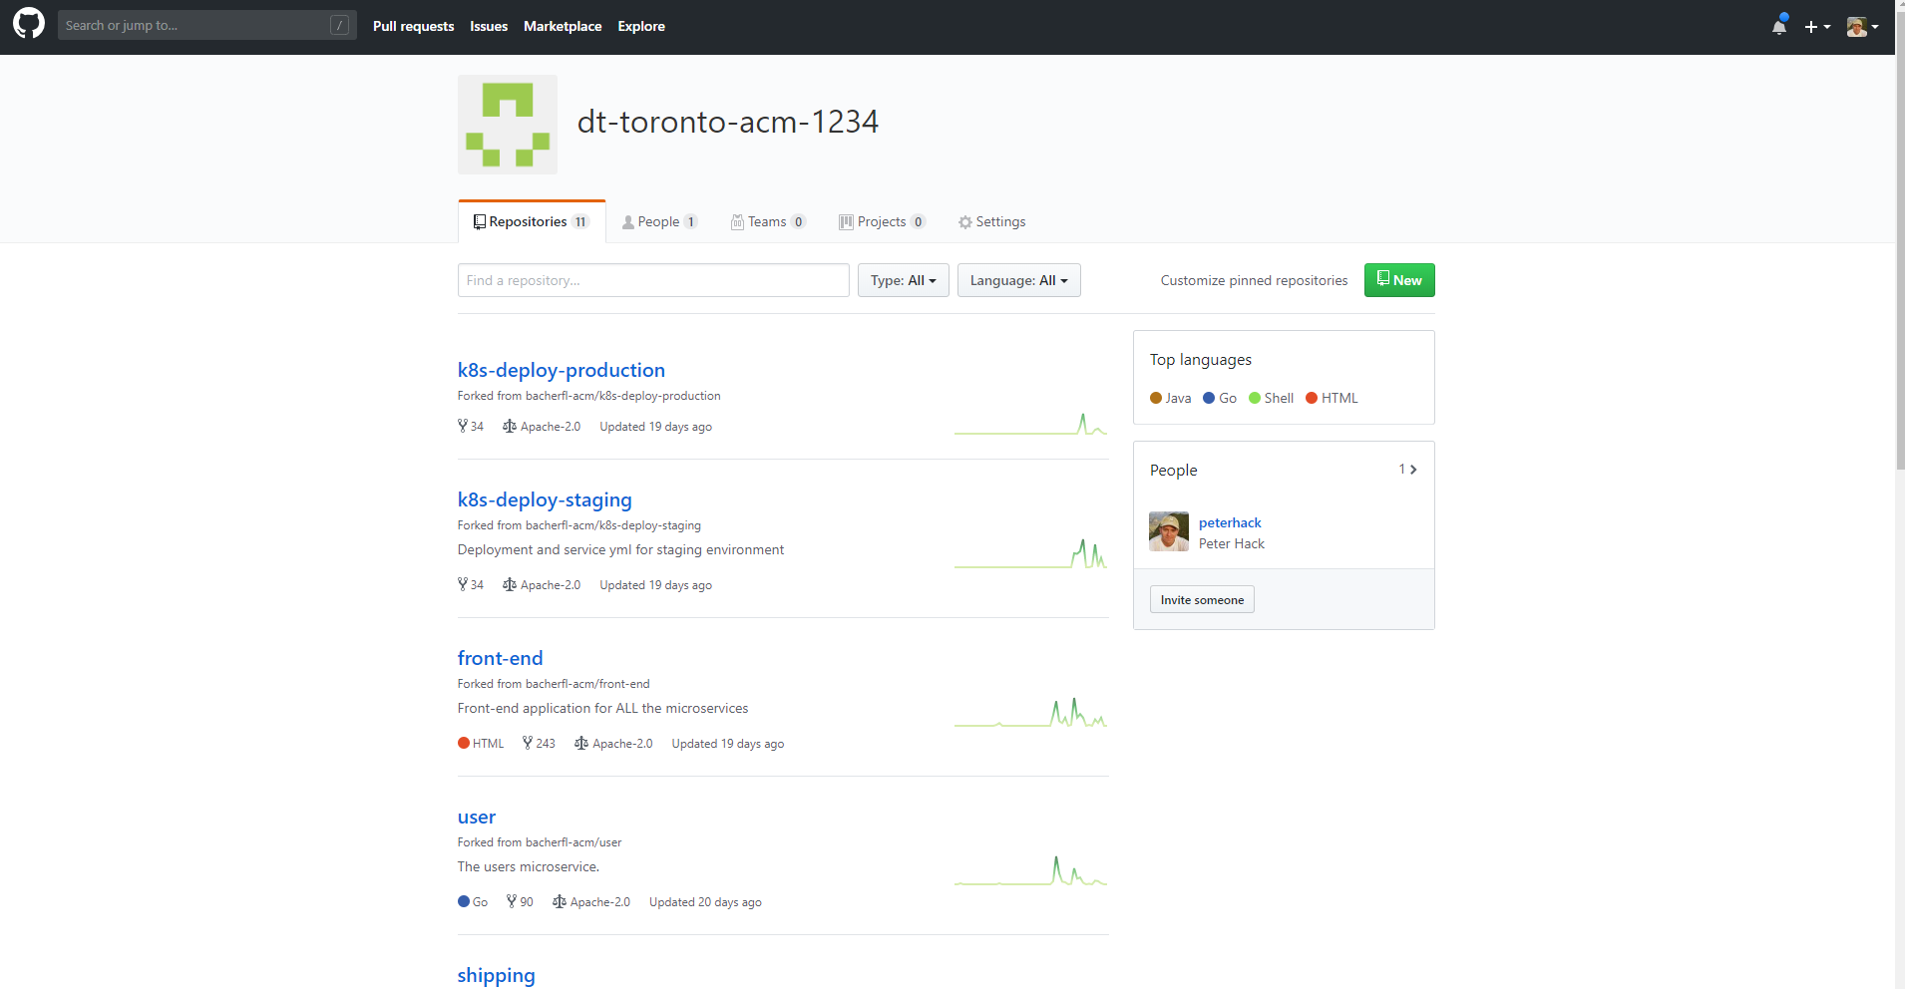
What just happened????
Building Environment Zero
The setup scripts will bring locally all of the Sockshop artifacts
Your Github Org should now have the repositories for all of the microservices
As part of the setup, we forked our demo repos to your new Github Organization

Slide 17
Workshop Setup
GitHub
Participant with Laptop
Bastion Host
OpenShift cluster

Slide 18
Workshop 1: Monitoring as a Service
Installing Dynatrace to enable monitoring as part of the platform

Slide 19
Workshop 1: Start
GitHub
Participant with Laptop
Bastion Host
OpenShift cluster

Slide 20
Monitoring as a Service
Create a Dynatrace Trial Tenant*
https://bit.ly/dtredhat
*if you already have a registered tenant with Dynatrace already, please let me know

Slide 21
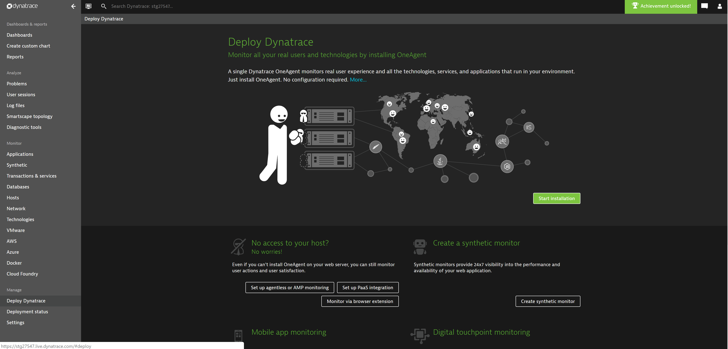
Gathering tenant credentials
Monitoring as a Service
Log into your tenant
Select “Deploy Dynatrace”
Select “Set up PaaS integration”
*if you already have a registered tenant with Dynatrace already, please let me know
1
2

Slide 22
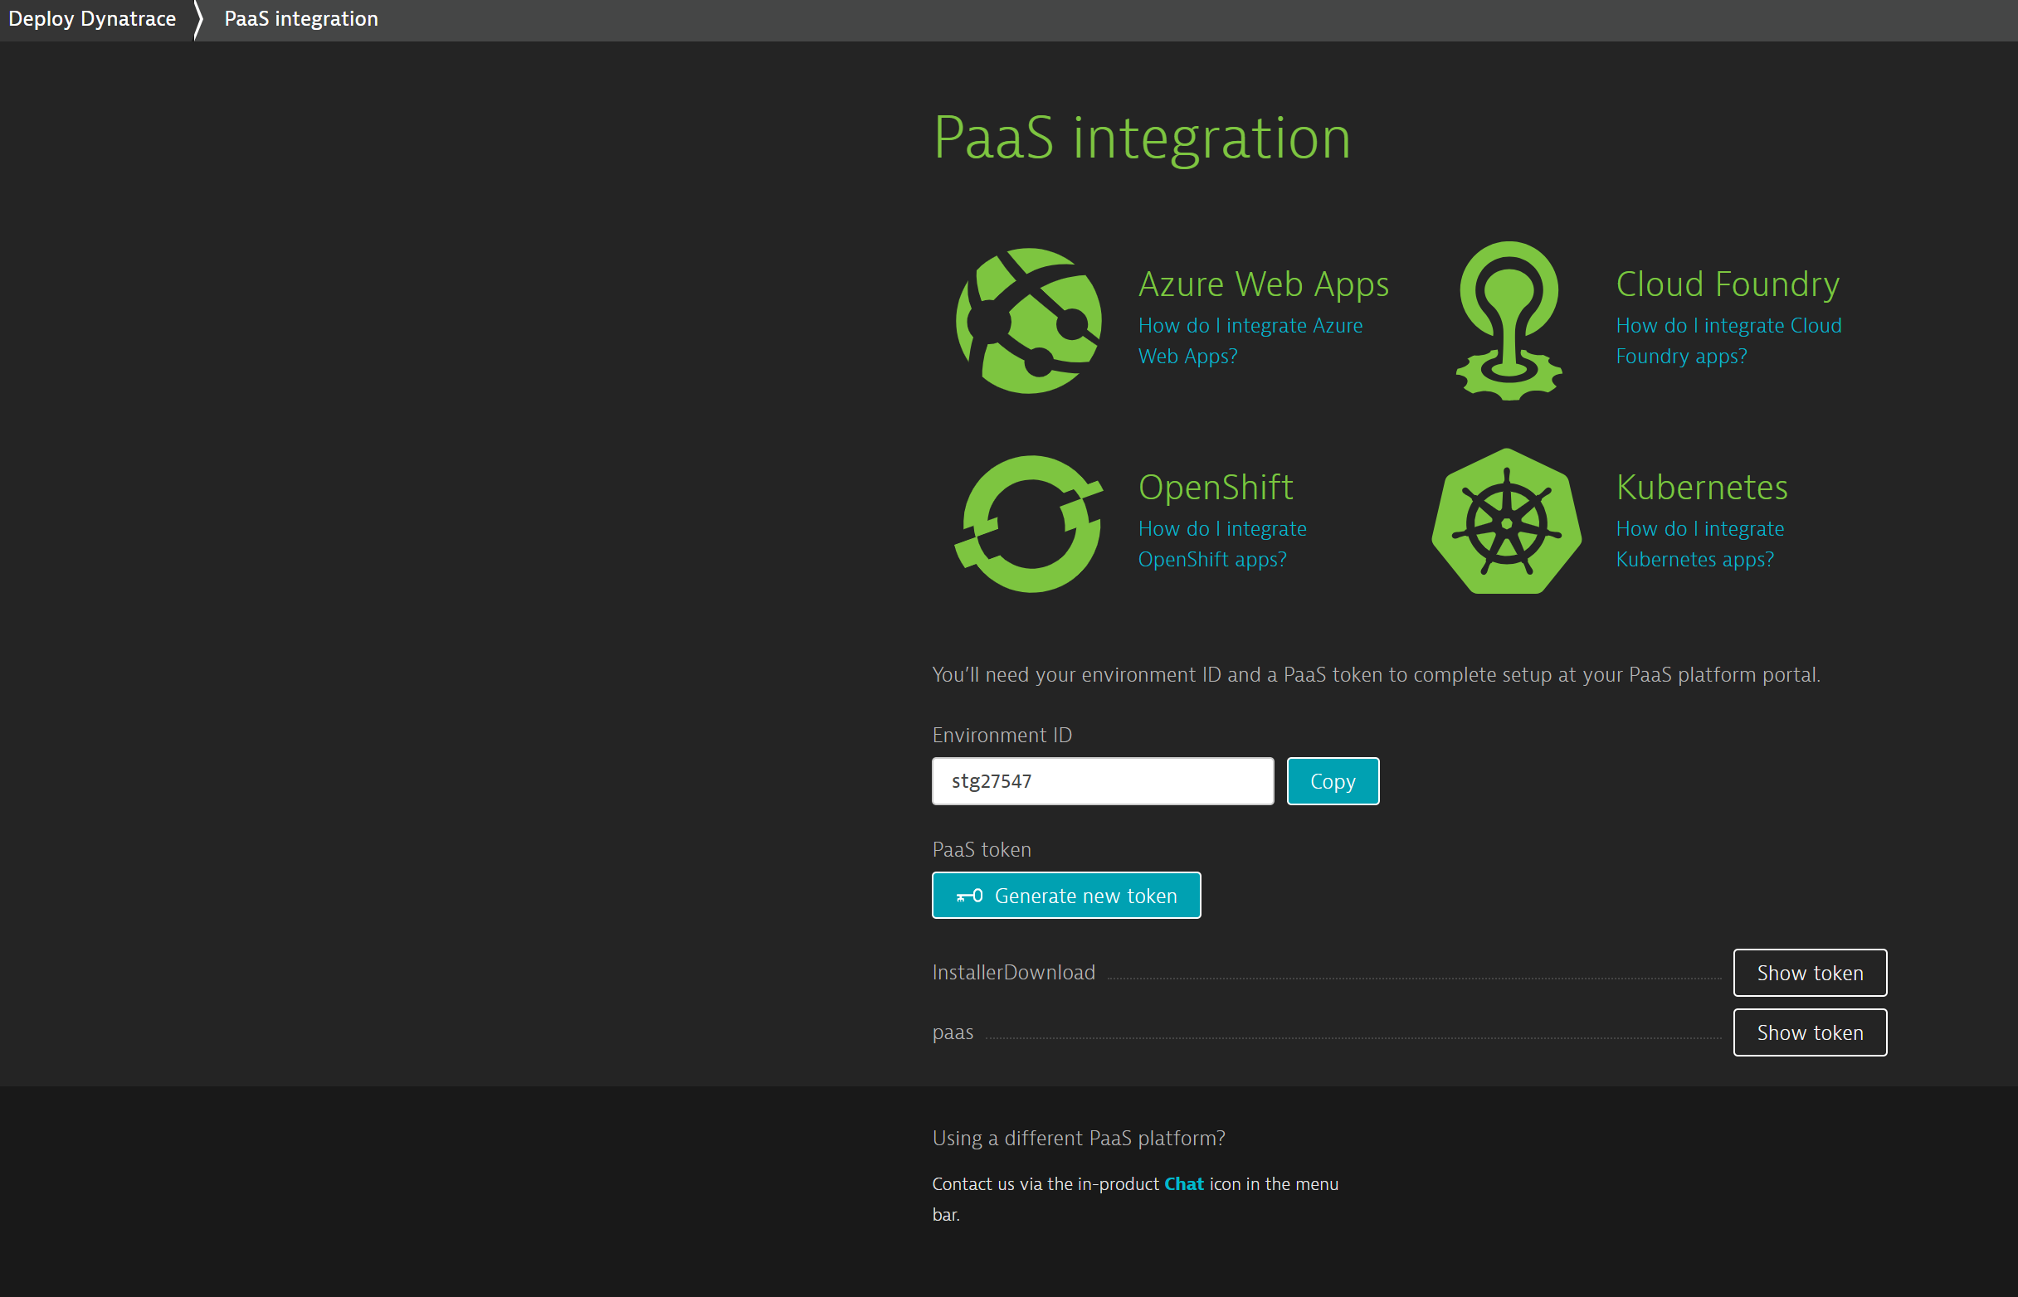
Gathering tenant credentials
Monitoring as a Service
Save these details for later use
Environment ID
API/Installer token
PaaS token
1
2
3

Slide 23
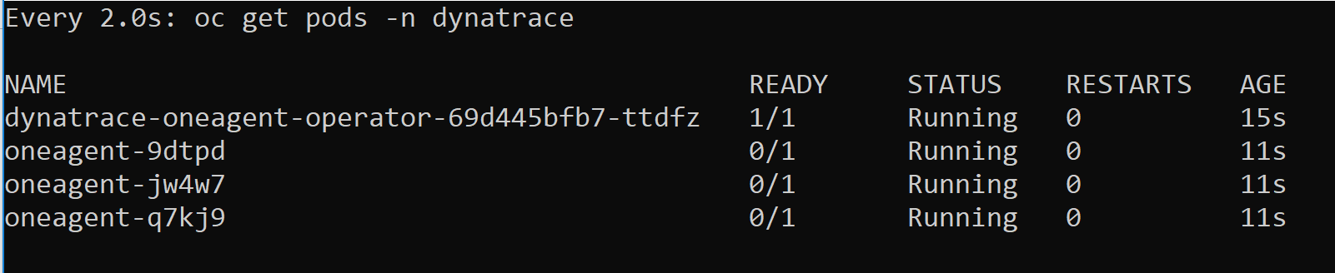
Deploying the OneAgent Operator
Monitoring as a Service
Using the apply.sh script, deploy the OneAgent Operator to automatically monitor all nodes
For more details, view the Dynatrace Help page on deploying the OneAgent
[ec2-user@bastion]$ cd ~/Dynatrace-oneagent-operator/deploy
[ec2-user@bastion deploy]$ ./apply.sh
...
[ec2-user@bastion deploy]$ watch oc get pods –n dynatrace

Slide 24
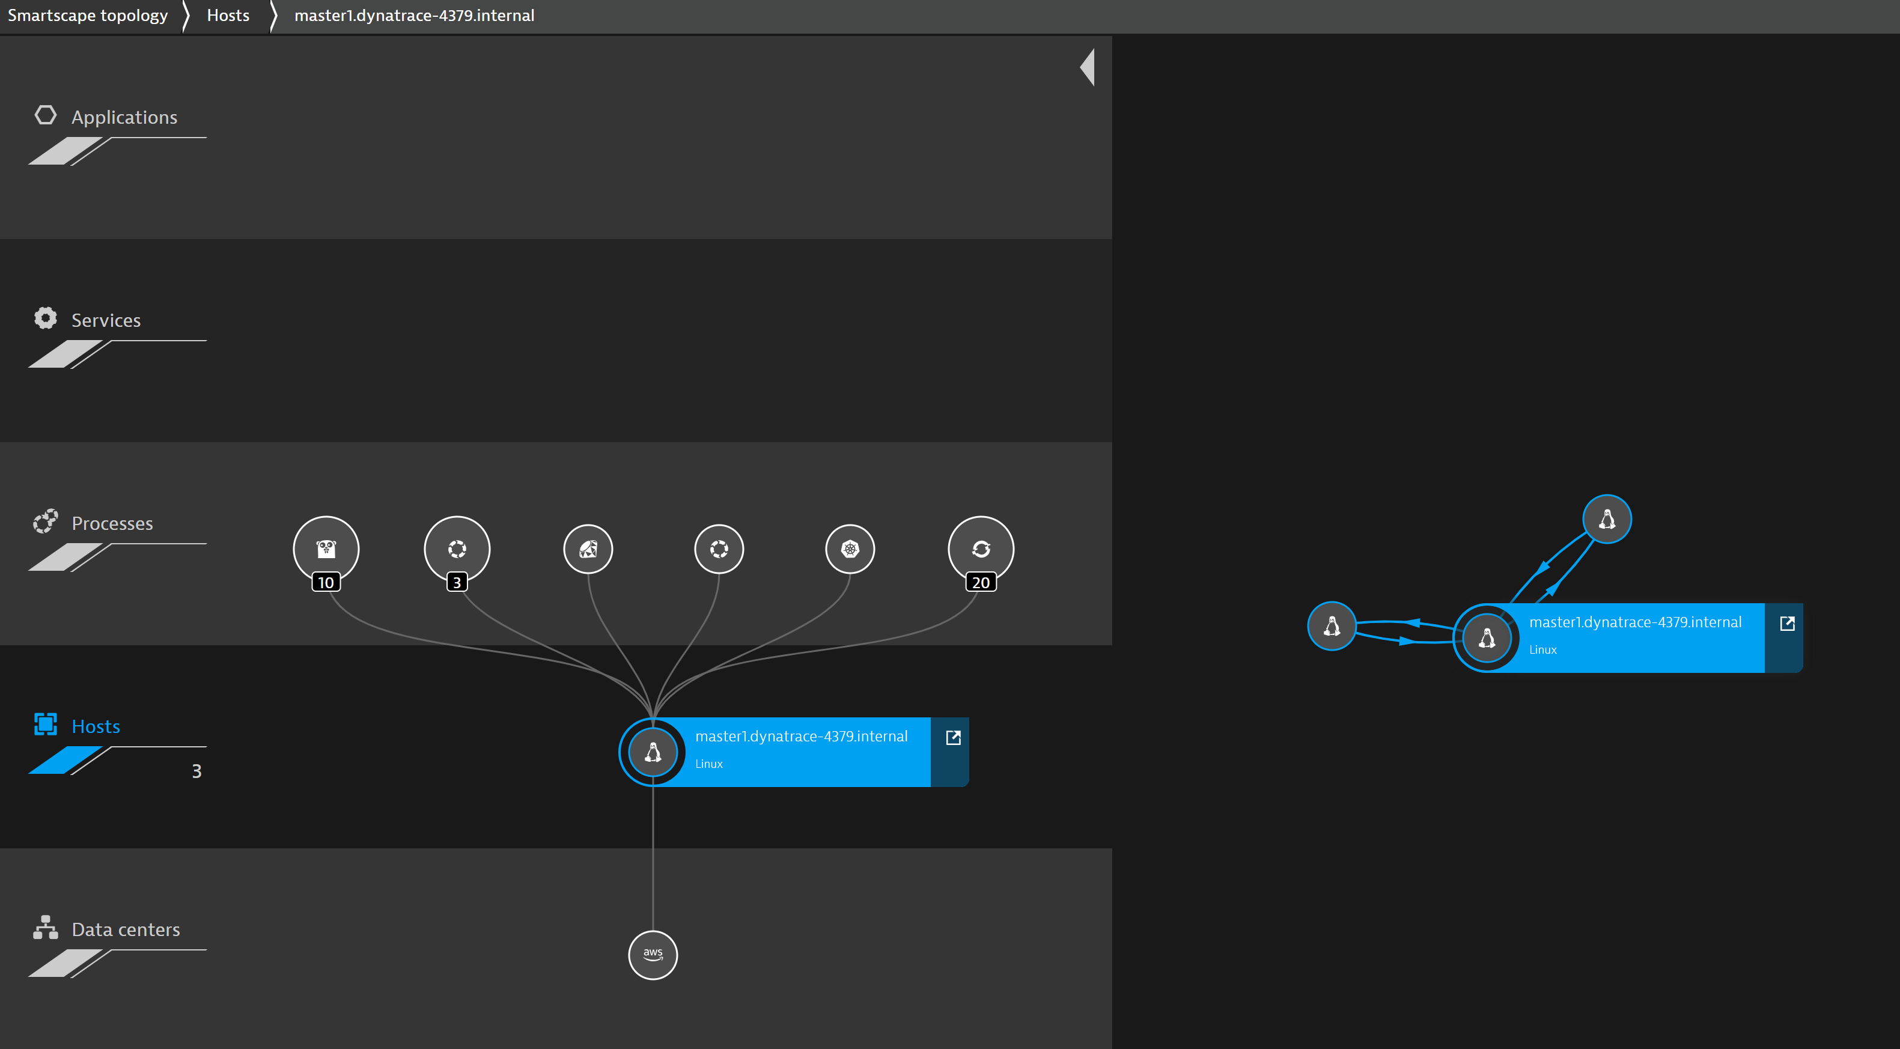
Monitoring is now part of the platform
Monitoring as a Service
Autodiscovery and full-stack observability as part of the platform
Notes:
We are jumping around here. At this point we need to run the Jenkins script and deploy the environment in section 04 Building Env. Zero in the ACL. We will come back to this section (06 Monitoring as a Service) during the Building Env. Zero and Performance as a Self Service sections for Tagging

Slide 25
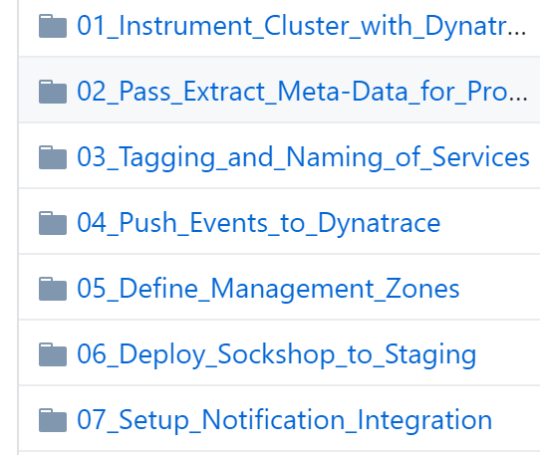
https://github.com/dt-toronto-acm/acm-docs/tree/master/workshop/06_Monitoring_as_a_Service
Monitoring as a Service
Continue on with Monitoring as a Service labs in the ‘acm-docs’ repo:
Complete highlighted labs
Notes:
We are jumping around here. At this point we need to run the Jenkins script and deploy the environment in section 04 Building Env. Zero in the ACL. We will come back to this section (06 Monitoring as a Service) during the Building Env. Zero and Performance as a Self Service sections for Tagging

Slide 26
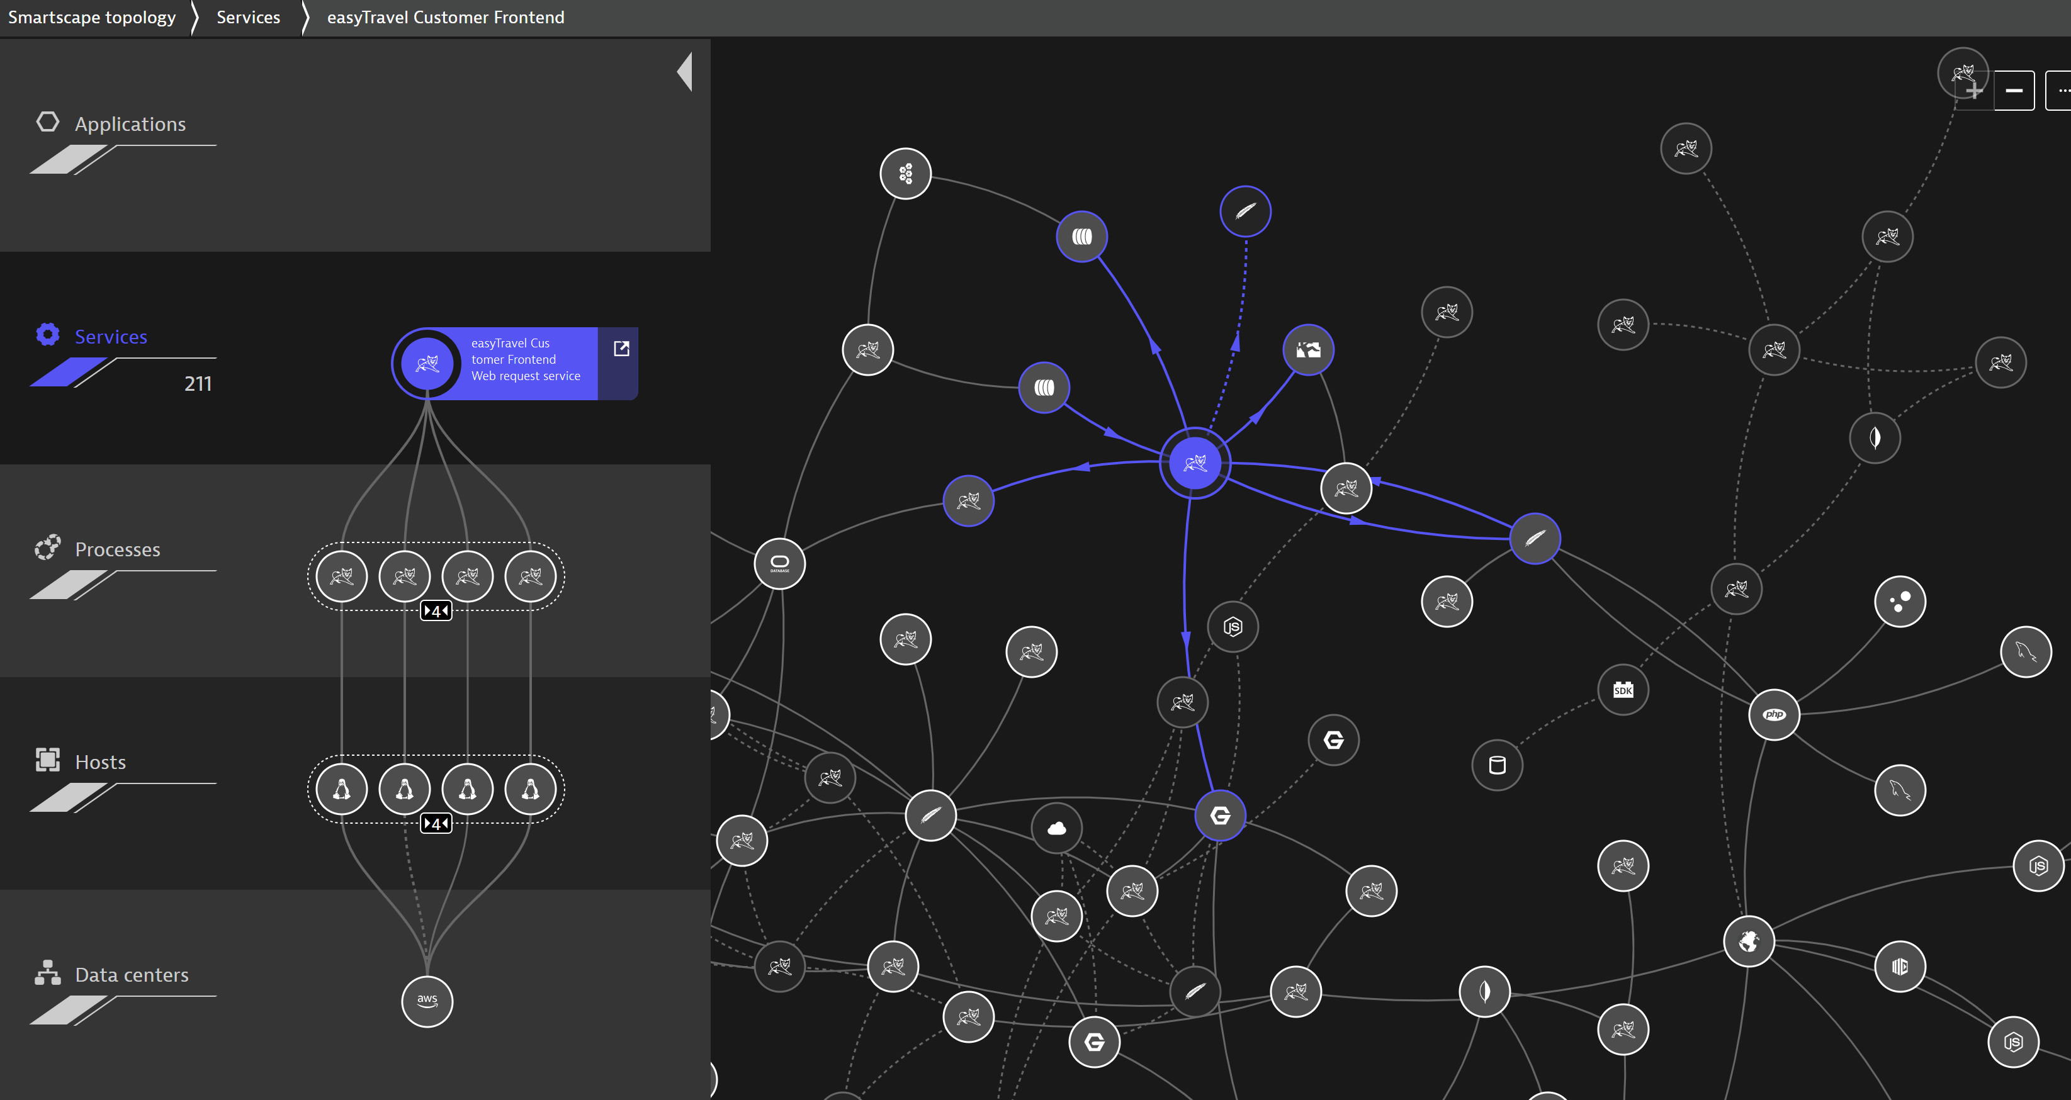
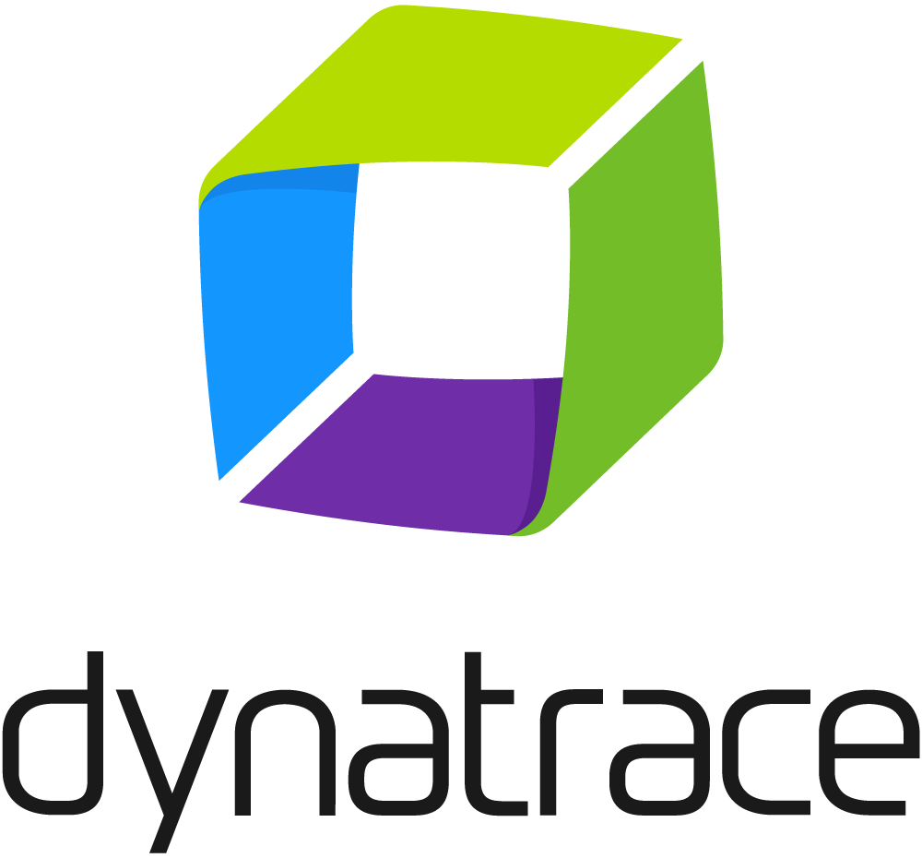
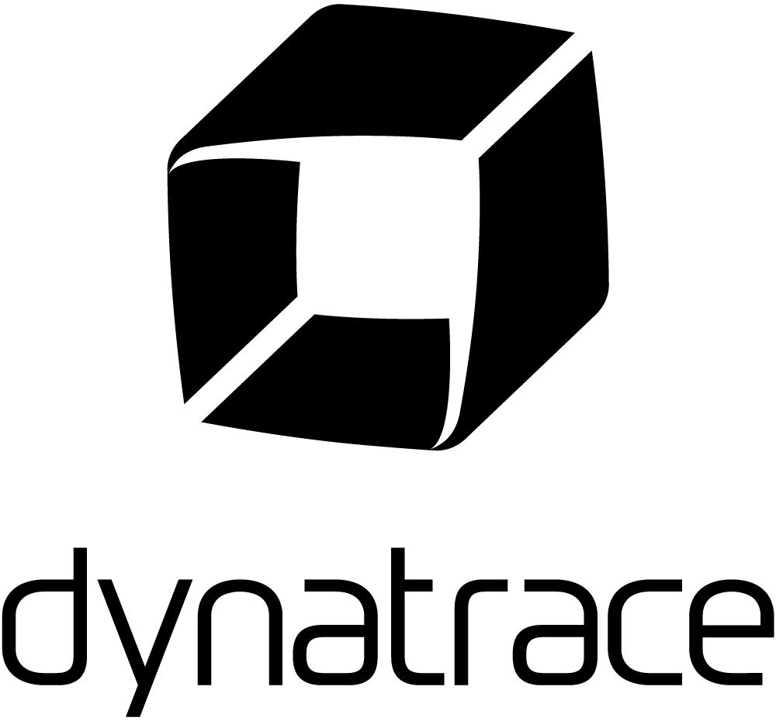
Workshop 1: Completed
GitHub
Participant with Laptop
Bastion Host
GitHub repositories
catalogue
carts
front-end
jmeter-tests
...
GitHub repositories
catalogue
carts
front-end
jmeter-tests
...
OpenShift cluster

Slide 27
Workshop 2: Building Environment Zero
Using OpenShift and Jenkins to empower your microservices

Slide 28
Workshop 2: Setup
GitHub
Participant with Laptop
Bastion Host
OpenShift cluster

Slide 29
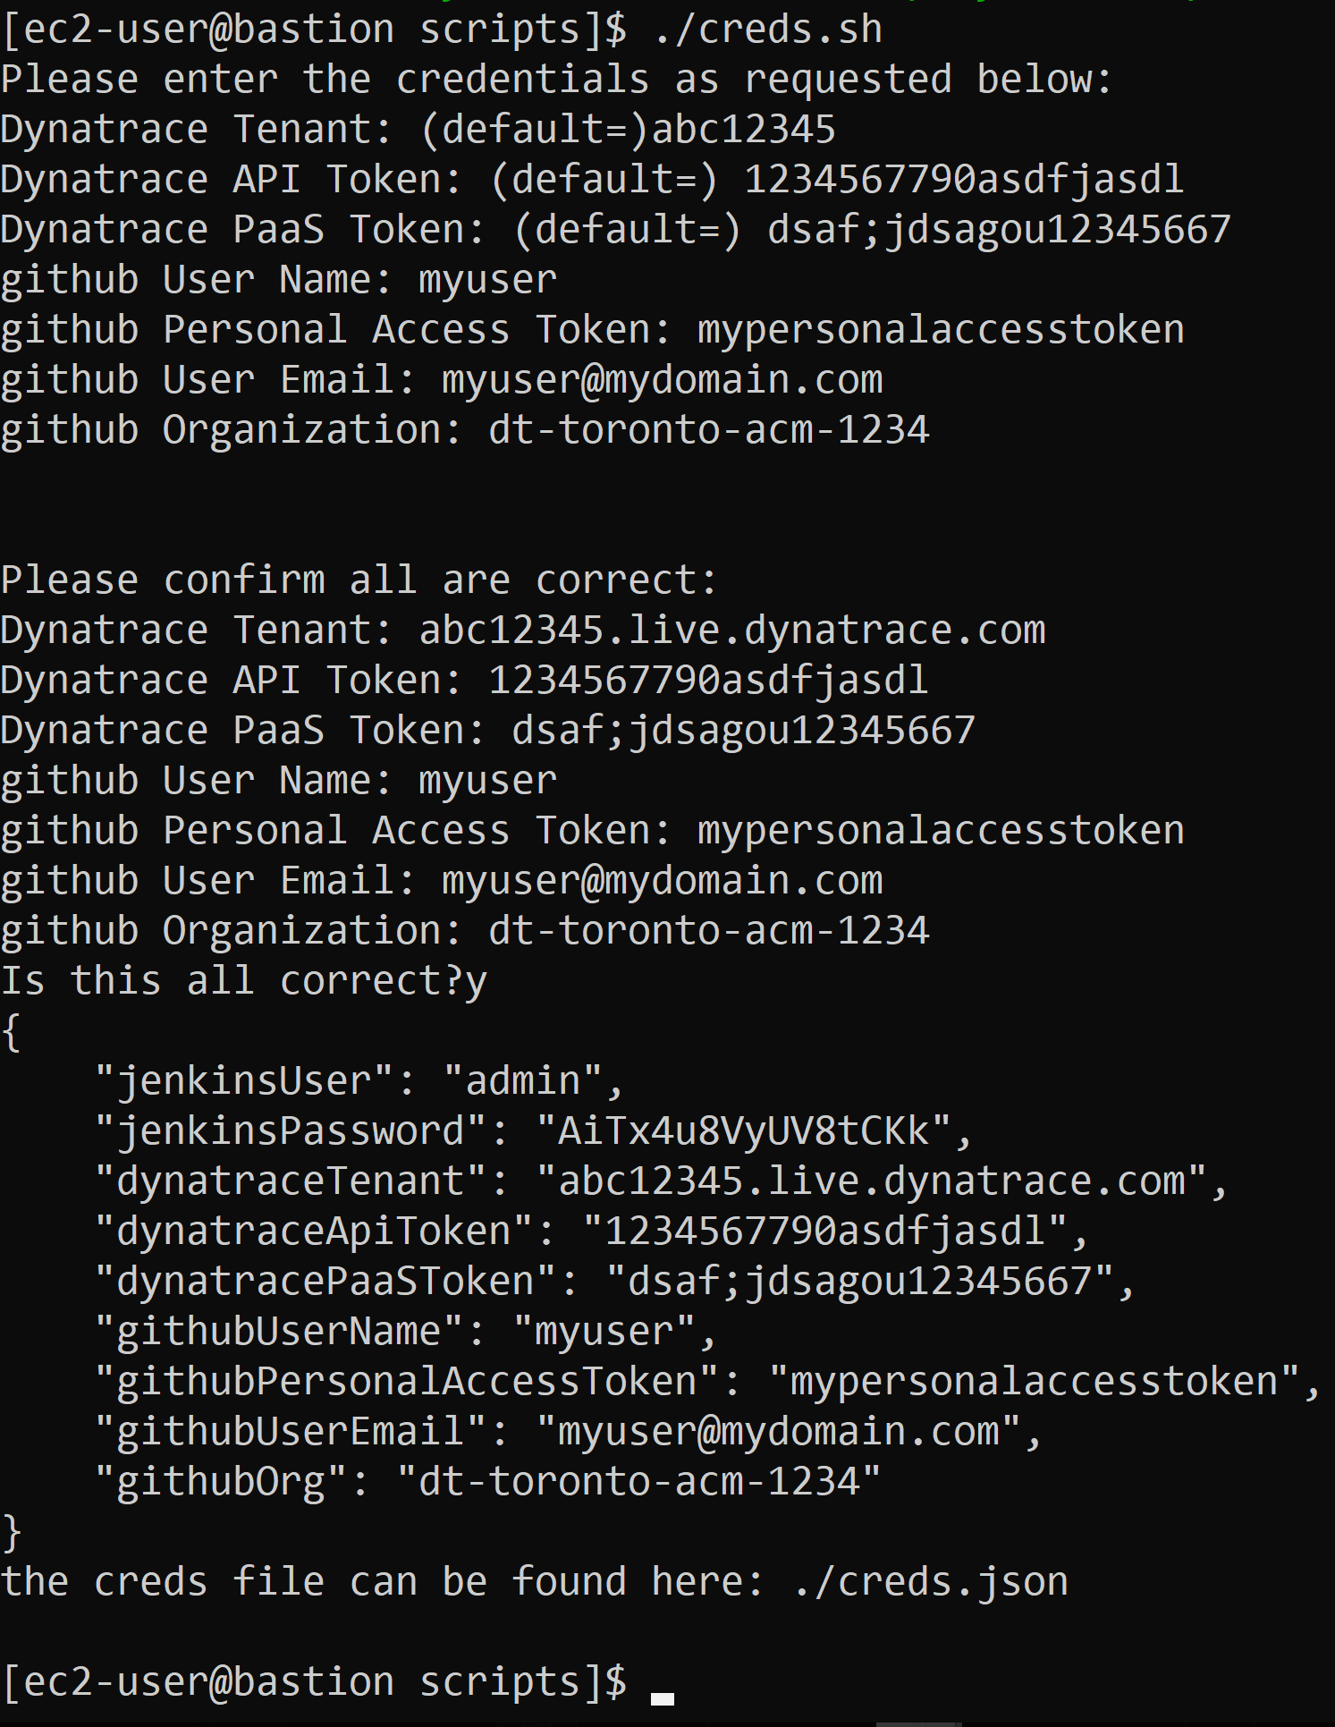
Configure credentials for lab
Building Environment Zero
The following steps will deploy the full SockShop application and demo workshops.
This first step will capture all of your credentials for the infrastructure deployment
[ec2-user@bastion]$ cd ~/provision-acm-openshift/scripts/
[ec2-user@bastion}$ ./creds.sh
Notes:
This is Section 4 of Workshop 04, however much is automated to this point. Need to complete this with a number of details collected earlier.

Slide 30
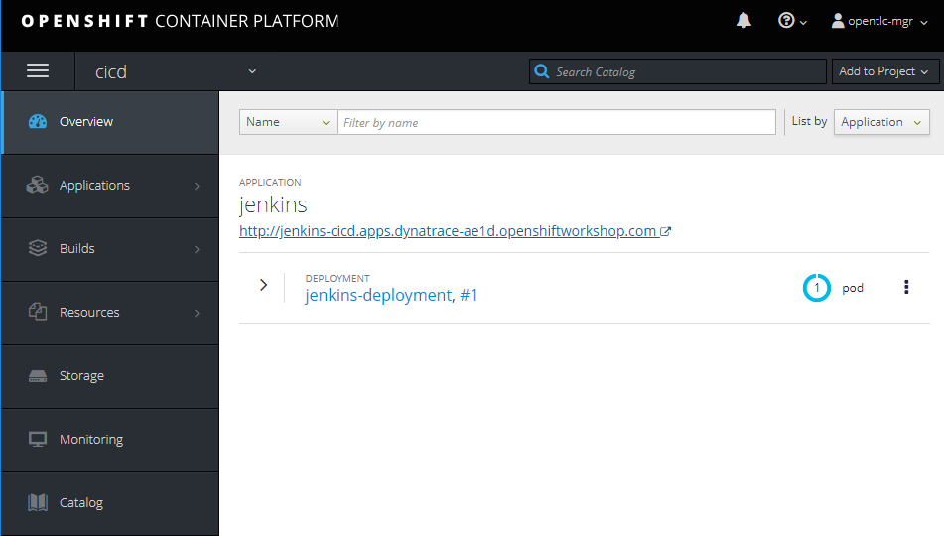
Configuring Jenkins
Building Environment Zero
Log into your OpenShift console and select the ‘cicd’ project
Select Jenkins URL to access the Jenkins Console

Slide 31
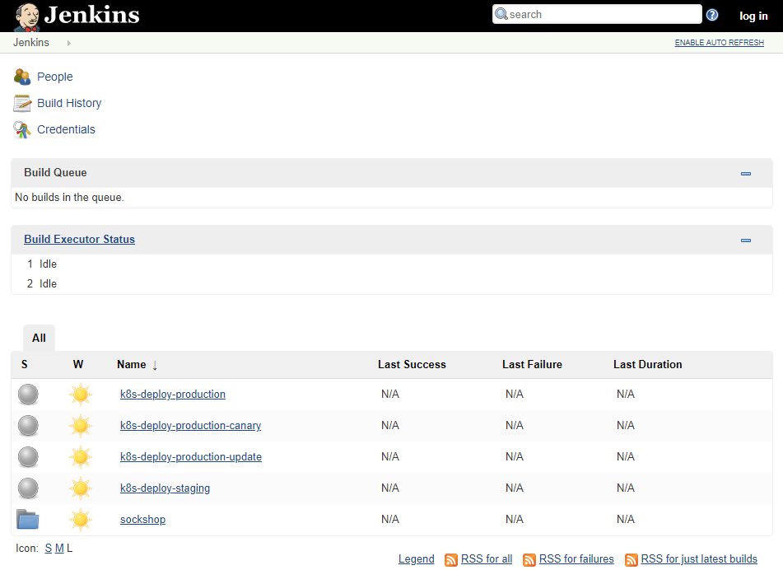
Configuring Jenkins
Building Environment Zero
Select ‘log in’ in your Jenkins Console
User: admin
Pwd: AiTx4u8VyUV8tCKk

Slide 32
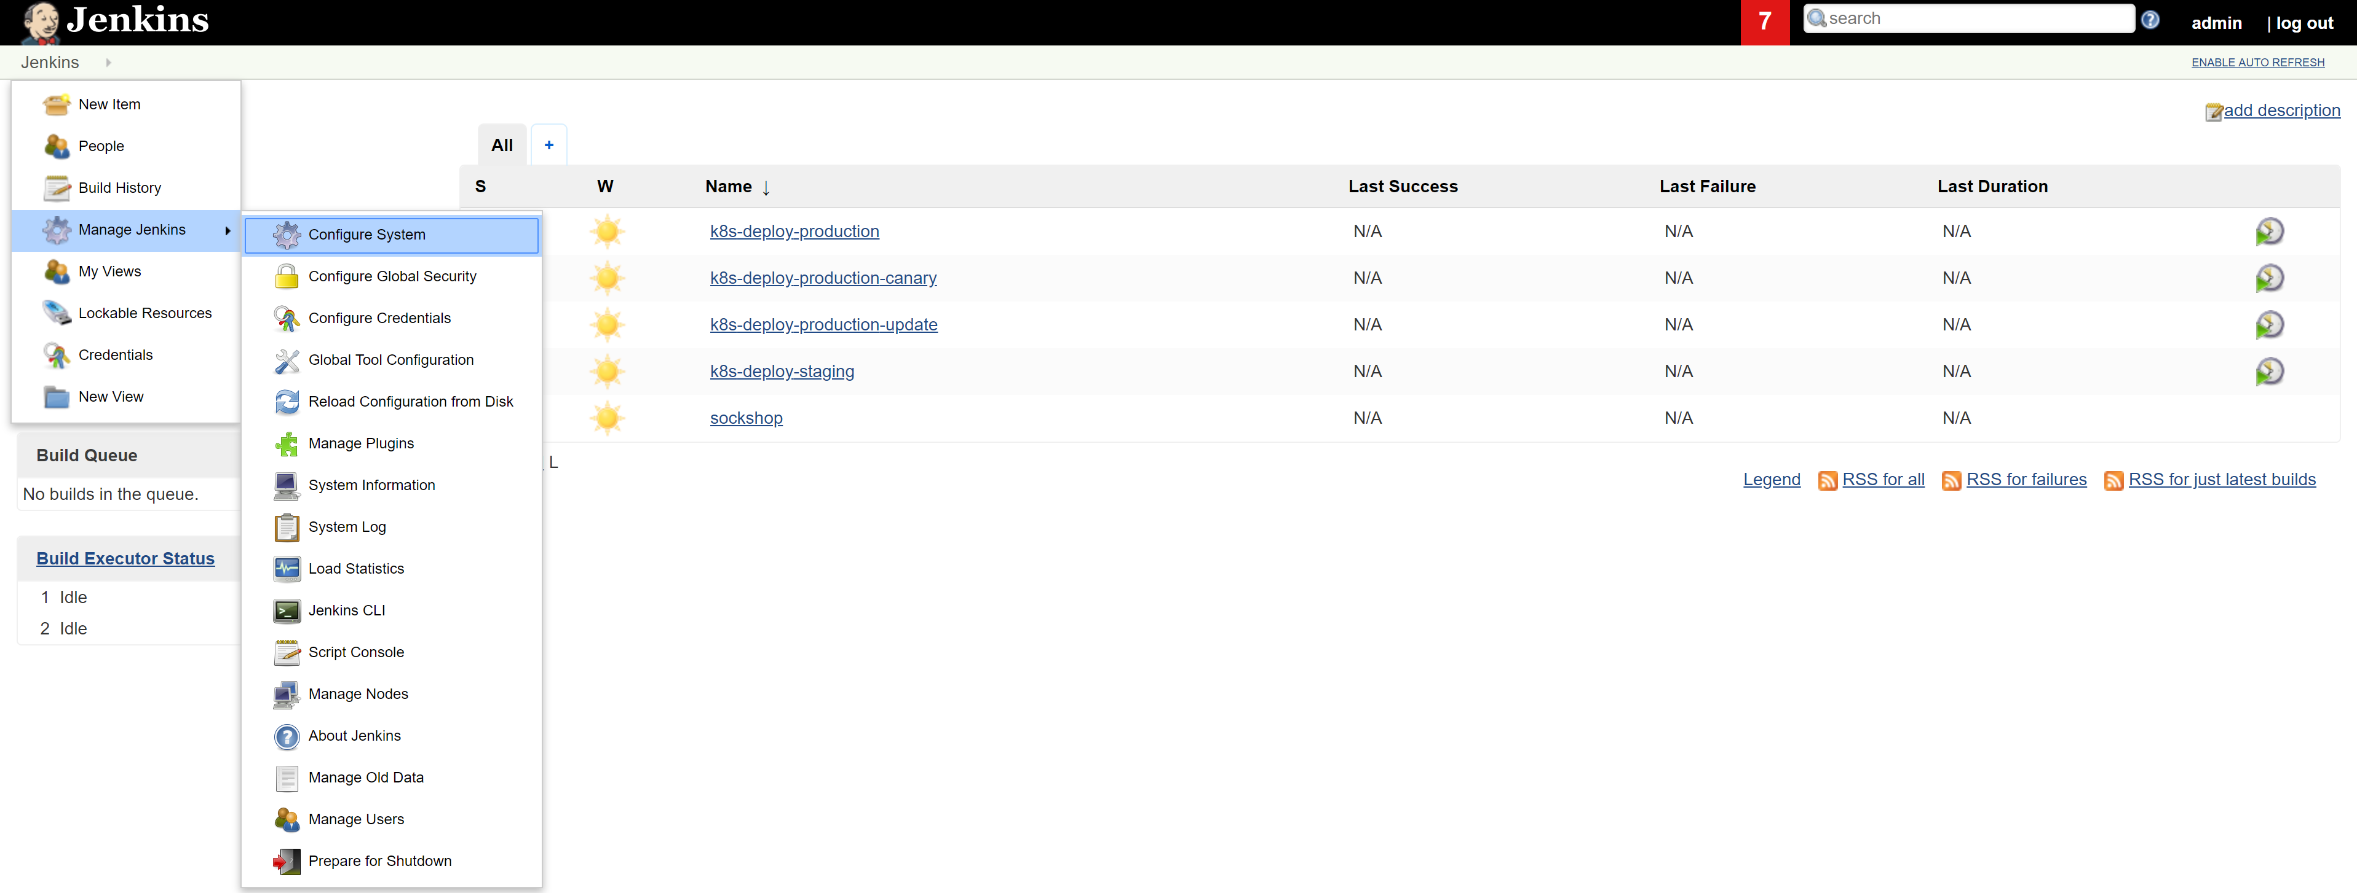
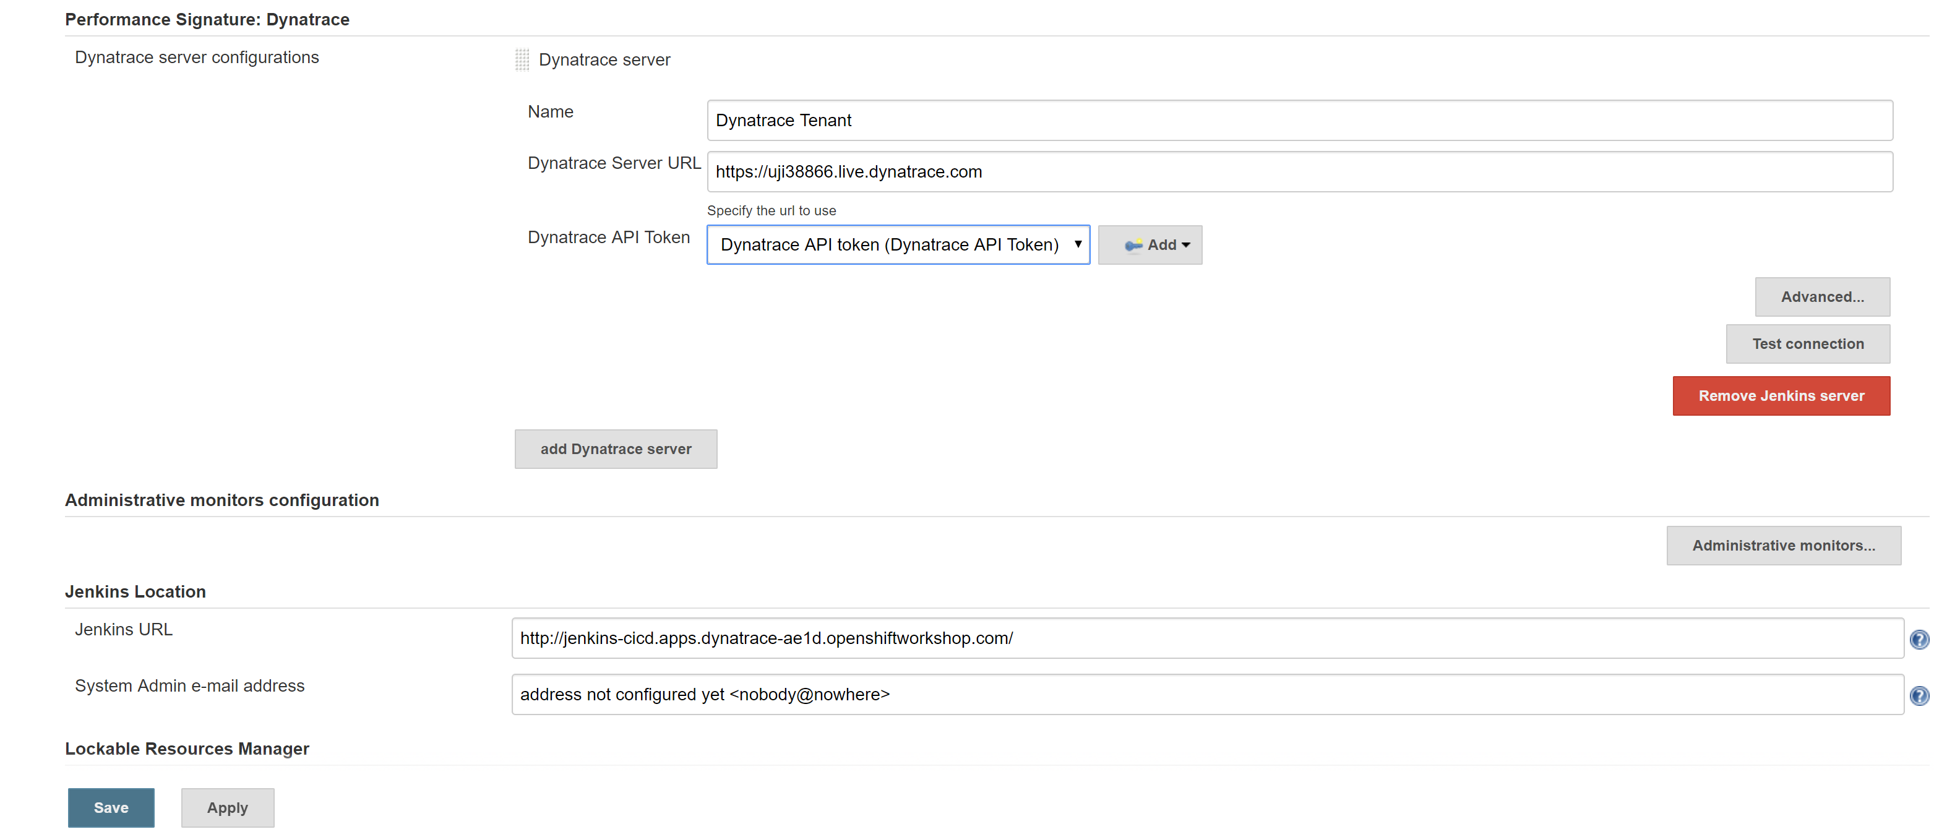
Configuring Jenkins
Building Environment Zero
Select ‘Manage Jenkins -> Configure System’ in your Jenkins Console
Scroll down to ‘Performance Signature: Dynatrace’
Note that your credentials from earlier have all be configured in Jenkins for you
Notes:
https://github.com/dynatrace-innovationlab/acl-docs/tree/master/workshop/04_Building_Environment_zero/4_Deploy_Jenkins

Slide 33
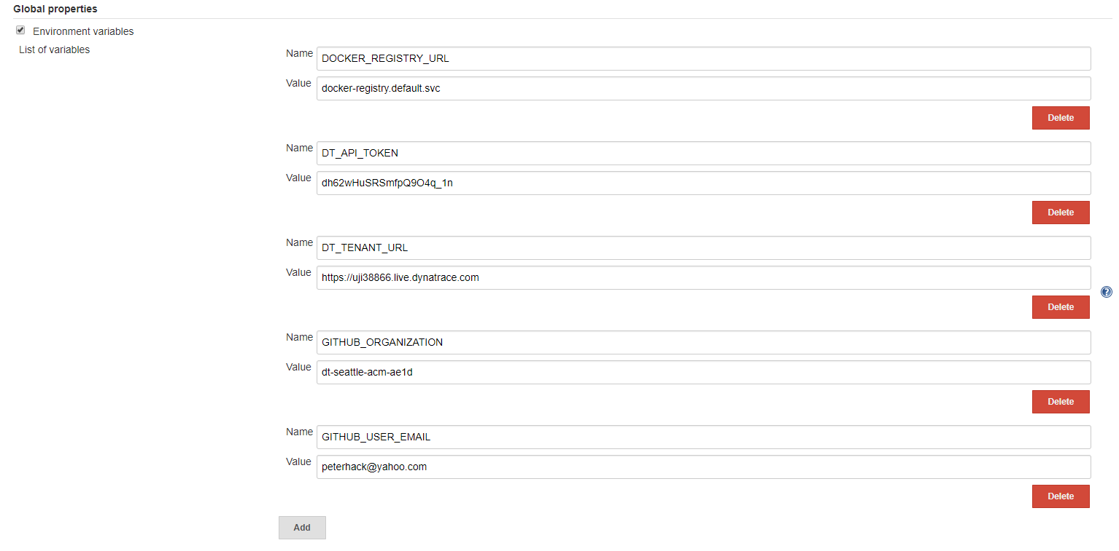
Configuring Jenkins
Building Environment Zero
Select ‘Manage Jenkins -> Configure System’ in your Jenkins Console
Scroll down to ‘Global properties’ and confirm the details are correct
Notes:
https://github.com/dynatrace-innovationlab/acl-docs/tree/master/workshop/04_Building_Environment_zero/4_Deploy_Jenkins

Slide 34
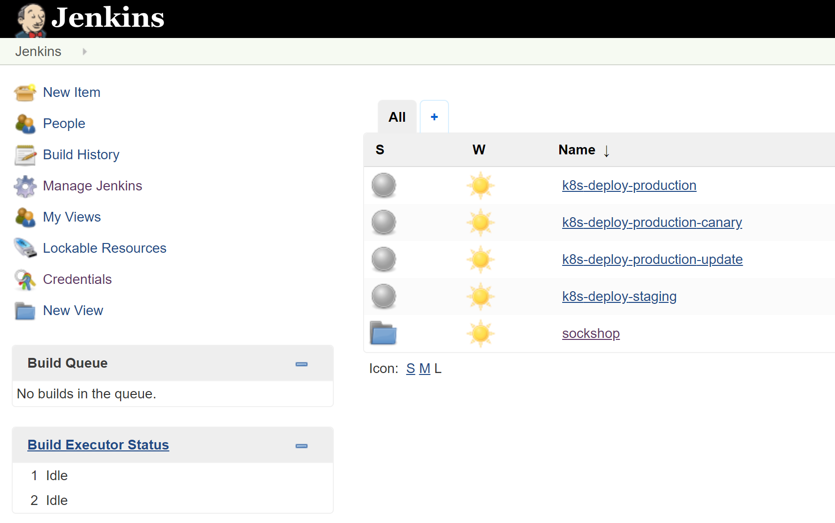
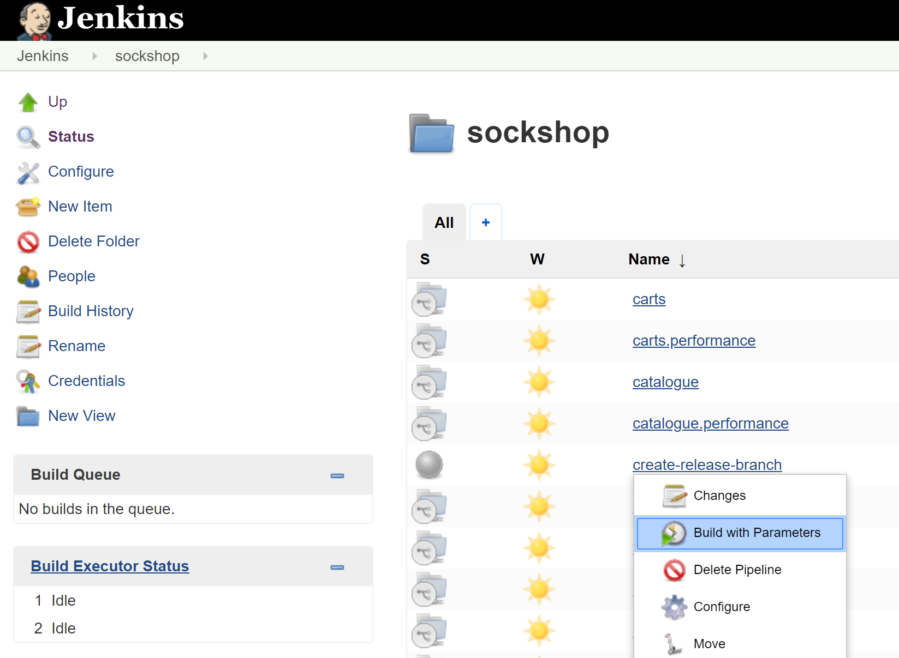
Starting the pipeline
Building Environment Zero
Select Sockshop from Jenkins homepage
Select ‘Build with parameters’ from the ‘create-release-branch’ drop-down menu
Notes:
https://github.com/dynatrace-innovationlab/acl-docs/tree/master/workshop/04_Building_Environment_zero/4_Deploy_Jenkins

Slide 35
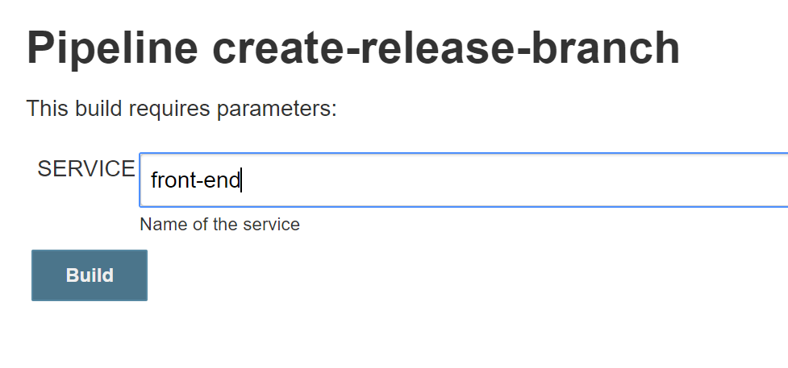
Starting the pipeline
Building Environment Zero
Enter ’front-end’ for the service to build
Select ‘Build’ to start the pipeline
Notes:
https://github.com/dynatrace-innovationlab/acl-docs/tree/master/workshop/04_Building_Environment_zero/4_Deploy_Jenkins

Slide 36
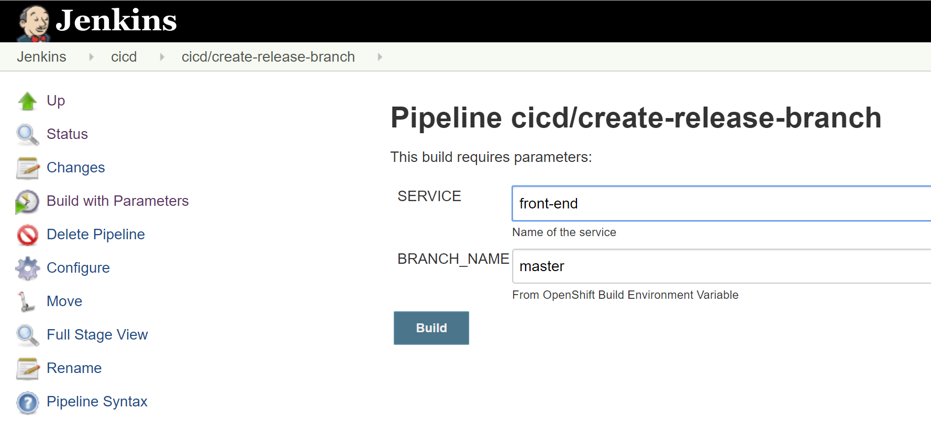
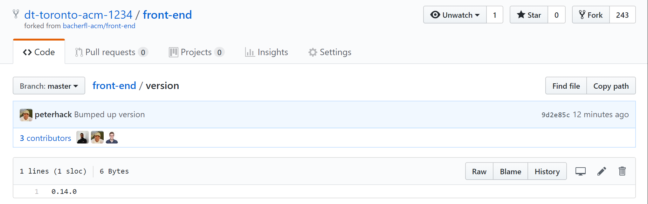
Starting the pipeline
Building Environment Zero
Enter ’front-end’ for the service to build
Select ‘Build’ to start the pipeline
The create-release-branch iterates the version of the service we are deploying
Notes:
https://github.com/dynatrace-innovationlab/acl-docs/tree/master/workshop/04_Building_Environment_zero/4_Deploy_Jenkins

Slide 37
Starting the pipeline
Building Environment Zero
Start the build for front-end in the command line using the ‘oc start-build’
[ec2-user@bastion scripts]$ oc project cicd
Now using project "cicd" on server "https://master1:443".
[ec2-user@bastion scripts]$ oc start-build front-end -e BRANCH_NAME=release/0.13.0
build.build.openshift.io/front-end-1 started
[ec2-user@bastion scripts]$
Notes:
https://github.com/dynatrace-innovationlab/acl-docs/tree/master/workshop/04_Building_Environment_zero/4_Deploy_Jenkins

Slide 38
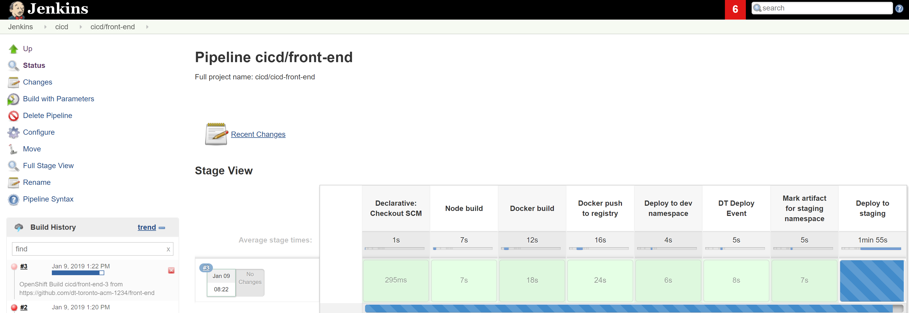
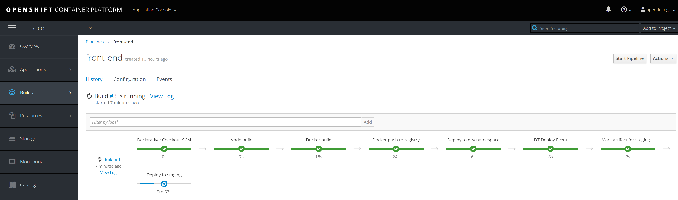
Starting the pipeline
Building Environment Zero
Follow the pipeline in the Jenkins console or in the OpenShift console
Notes:
https://github.com/dynatrace-innovationlab/acl-docs/tree/master/workshop/04_Building_Environment_zero/4_Deploy_Jenkins

Slide 39

Workshop 2: Completed
GitHub
Sockshop App
Participant with Laptop
Bastion Host
GitHub repositories
catalogue
carts
front-end
jmeter-tests
...
GitHub repositories
catalogue
carts
front-end
jmeter-tests
...
Jenkins
Docker Registry
OpenShift cluster

Slide 40
Workshop 3: Performance as a Self-Service
Democratizing performance using Jenkins, OpenShift and Dynatrace

Slide 41
Workshop 3: Setup
GitHub
Sockshop App
Participant with Laptop
Bastion Host
GitHub repositories
catalogue
carts
front-end
jmeter-tests
...
GitHub repositories
catalogue
carts
front-end
jmeter-tests
...
Jenkins
Docker Registry
OpenShift cluster

Slide 42
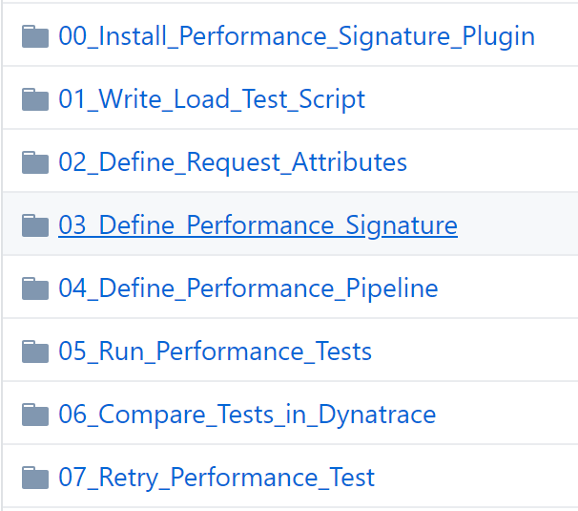
https://github.com/dt-toronto-acm/acm-docs/tree/master/workshop/07_Performance_as_a_Self_Service
Performance as a self-service
We have preconfigured the Performance Signature Plugin and Load Test scripts
Please review each lab and compare to your environment, however you only need to complete highlighted labs
Notes:
https://github.com/dynatrace-innovationlab/acl-docs/tree/master/workshop/04_Building_Environment_zero/4_Deploy_Jenkins

Slide 43
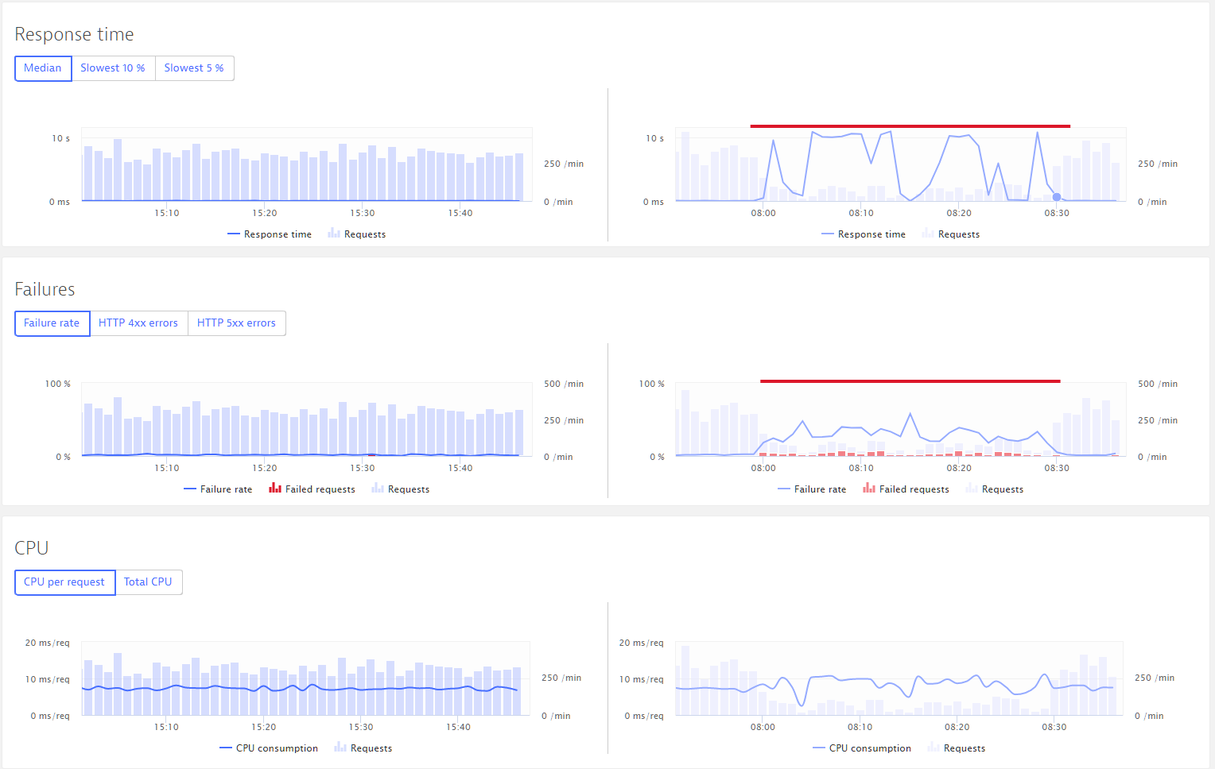
Workshop 3: Completed
GitHub
Sockshop App
Participant with Laptop
Bastion Host
GitHub repositories
catalogue
carts
front-end
jmeter-tests
...
GitHub repositories
catalogue
carts
front-end
jmeter-tests
...
Jenkins
Docker Registry
OpenShift cluster

Slide 44
Workshop 4: Runbook Automation
Combining a monitored OpenShift platform with Ansible automation to enable self-healing

Slide 45
Workshop 4: Setup
GitHub
Sockshop App
Participant with Laptop
Bastion Host
GitHub repositories
catalogue
carts
front-end
jmeter-tests
...
GitHub repositories
catalogue
carts
front-end
jmeter-tests
...
Jenkins
Docker Registry
OpenShift cluster

Slide 46
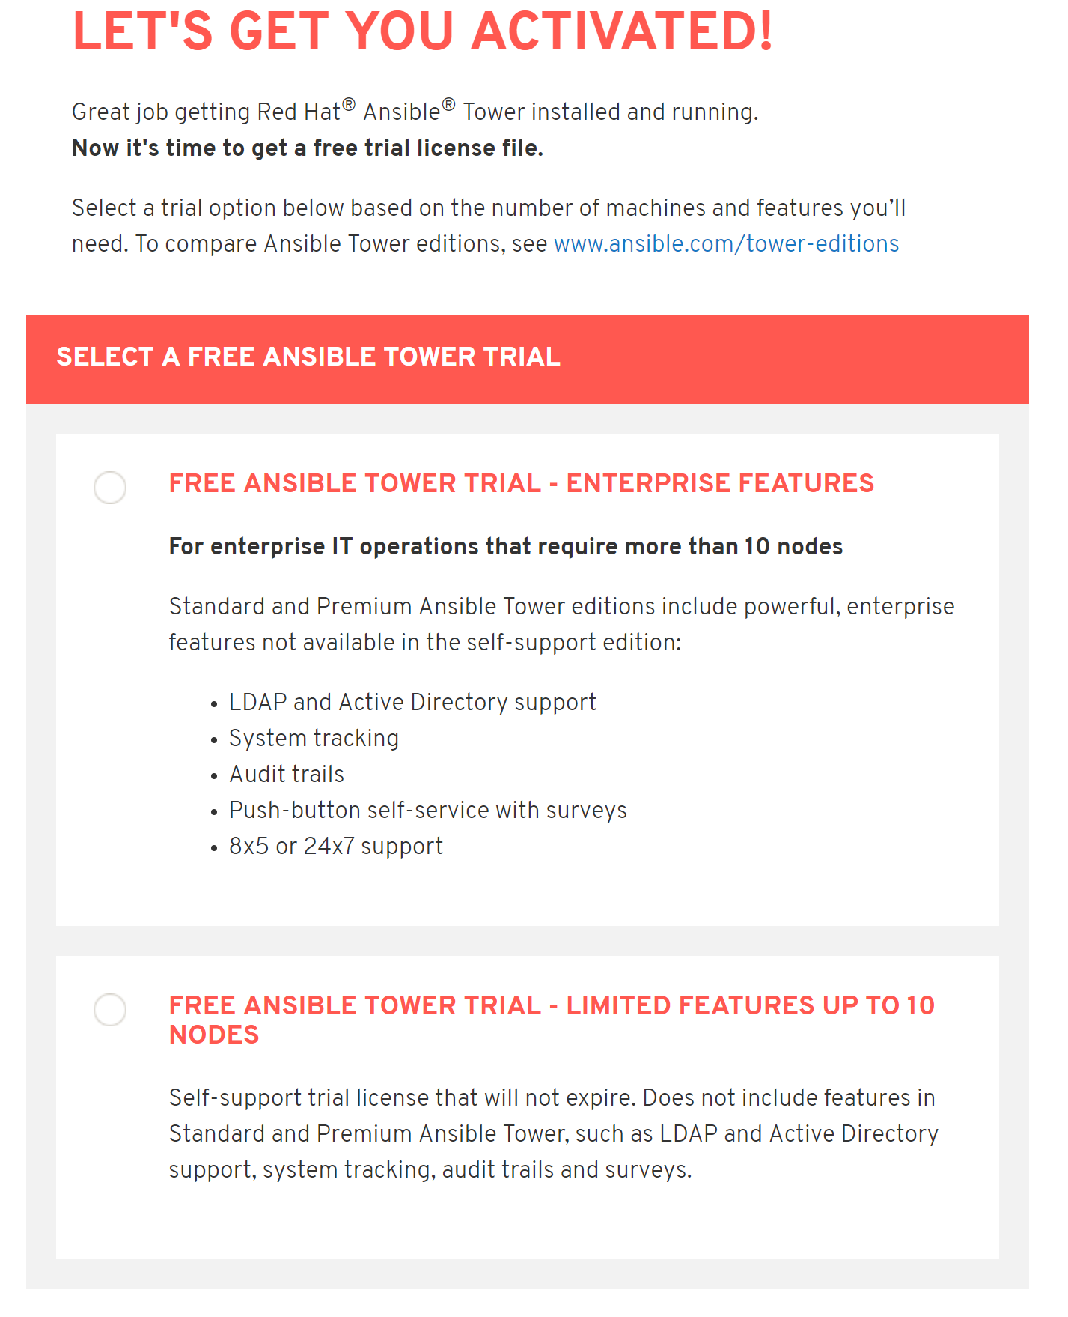
https://www.ansible.com/license
Runbook Automation and Self-Healing
To complete this lab requires Ansible Tower
You will need an Ansible Tower license… you can obtain a personal license for up to 10 hosts
Download the license file locally
Select Here
Notes:
This is Section 4 of Workshop 04, however much is automated to this point. Need to complete this with a number of details collected earlier.

Slide 47
Deploy Ansible
Runbook Automation and Self-Healing
Deploy Ansible
Once Deployed, you should see it in the OpenShift Console
Click on the Ansible Tower Service URL
[ec2-user@bastion ]$ cd ~/provision-acm-openshift/scripts
[ec2-user@bastion scripts]$ ./setup_ansible.sh
…
The setup process completed successfully.
Setup log saved to /home/ec2-user/provision-acm-openshift/scripts/setup_container_cluster-2019-01-09-05:29:04.log
[ec2-user@bastion scripts]$
Notes:
This is Section 4 of Workshop 04, however much is automated to this point. Need to complete this with a number of details collected earlier.

Slide 48
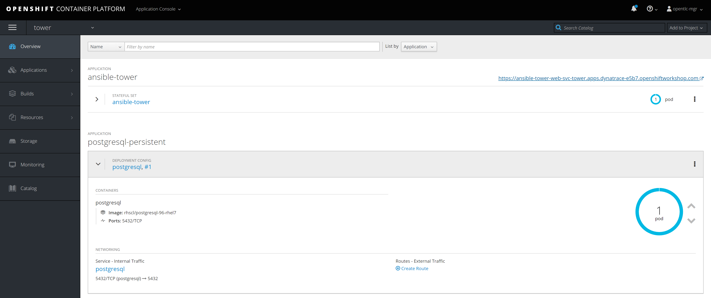
Open Ansible
Runbook Automation and Self-Healing
Once Deployed, you should see it in the OpenShift Console
Click on the Ansible Tower Service URL
Notes:
This is Section 4 of Workshop 04, however much is automated to this point. Need to complete this with a number of details collected earlier.

Slide 49
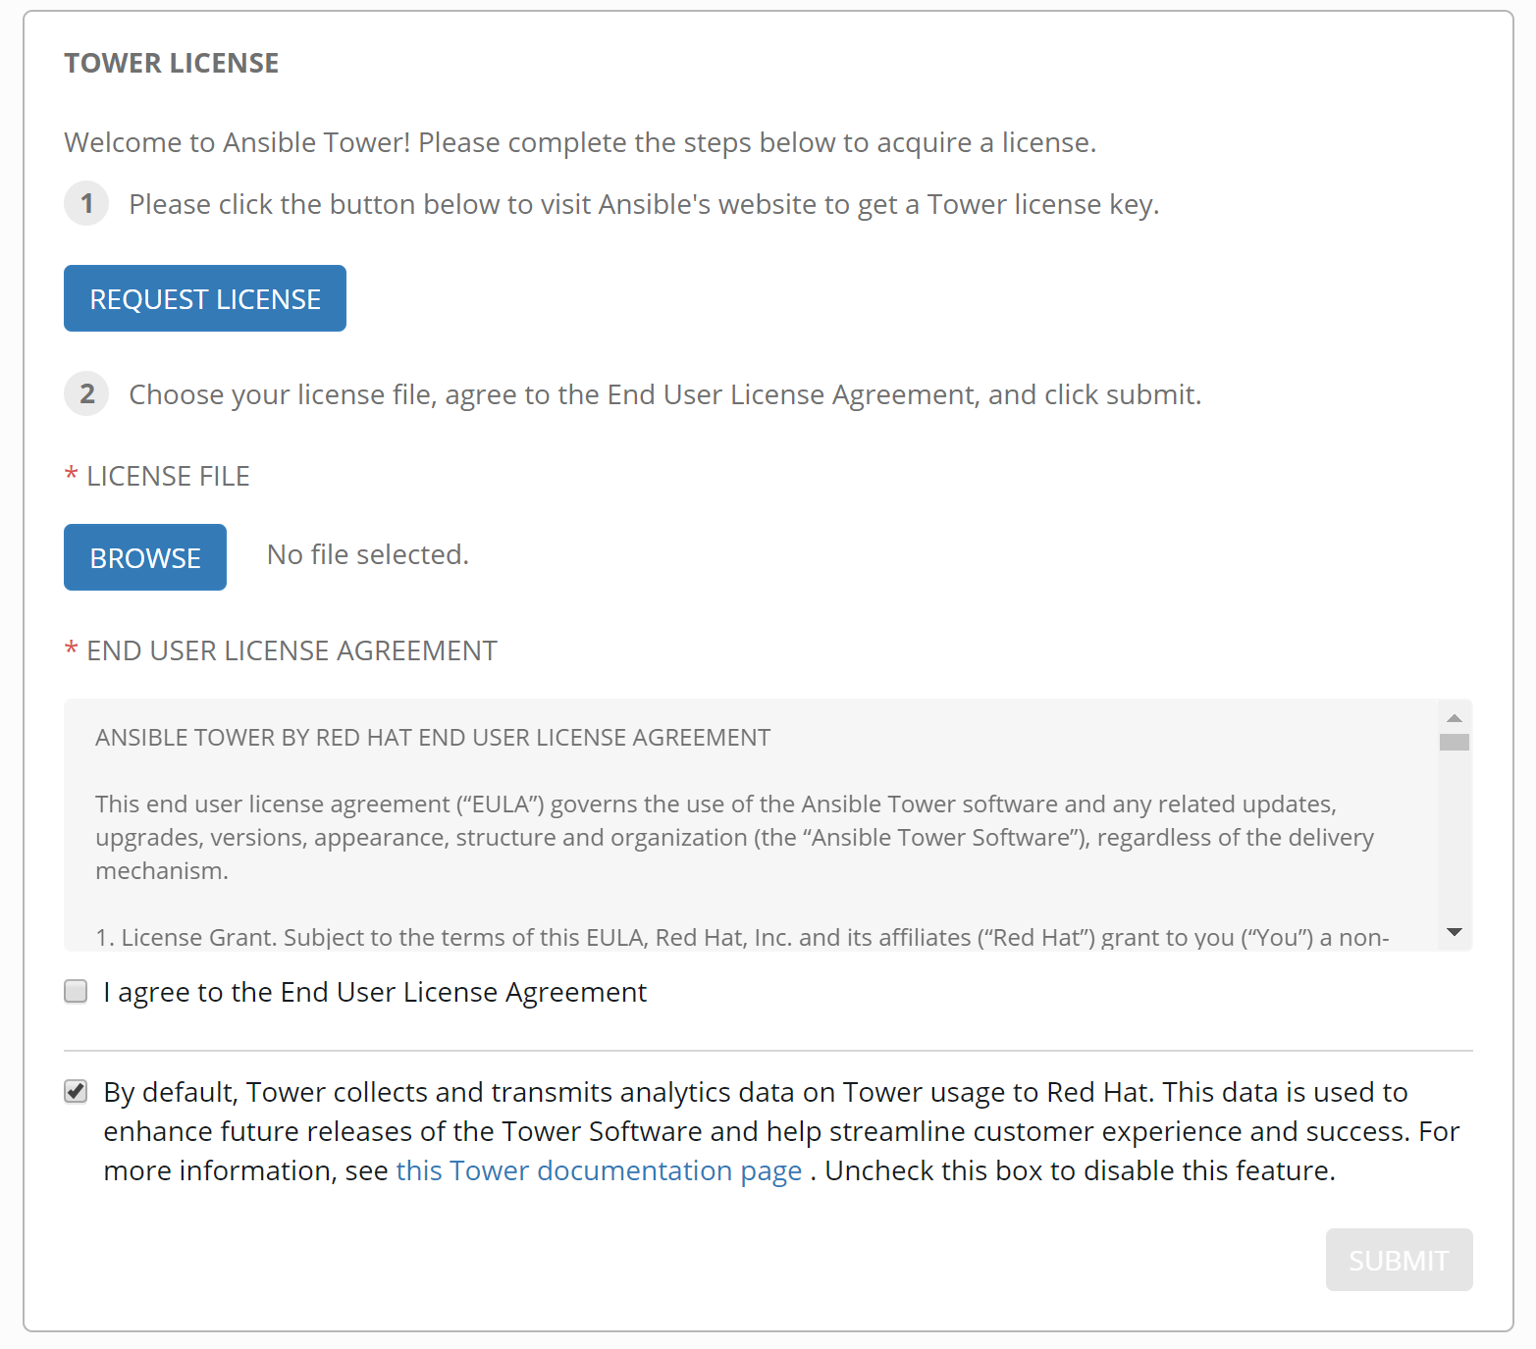
Configure Ansible
Runbook Automation and Self-Healing
Add your Ansible License that you downloaded
Agree to EULA
Select Submit
Notes:
This is Section 4 of Workshop 04, however much is automated to this point. Need to complete this with a number of details collected earlier.

Slide 50
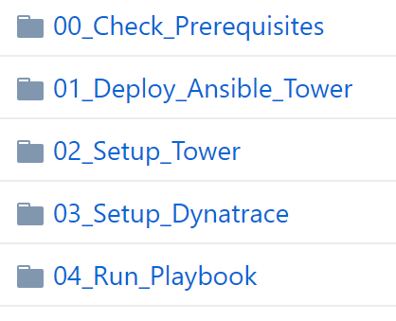
https://github.com/dt-toronto-acm/acm-docs/tree/master/workshop/09_Runbook_Automation_and_Self_Healing
Runbook Automation and Self-Healing
Continue on with Monitoring as a Service labs in the ‘acm-docs’ repo:
Complete highlighted labs
Notes:
This is Section 4 of Workshop 04, however much is automated to this point. Need to complete this with a number of details collected earlier.

Slide 51
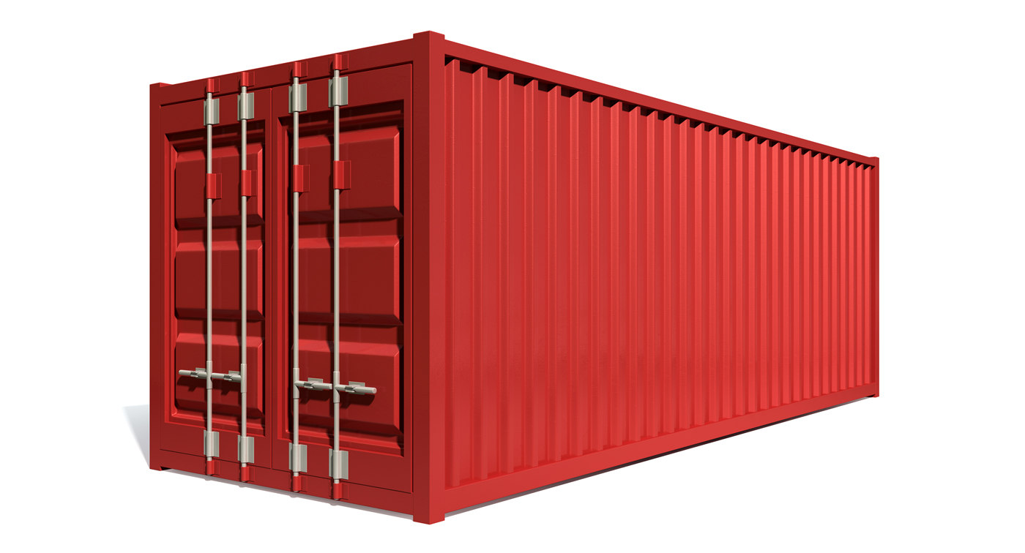



Workshop 4: Completed
GitHub
Sockshop App
Participant with Laptop
Bastion Host
GitHub repositories
catalogue
carts
front-end
jmeter-tests
...
Jenkins
Docker Registry
OpenShift cluster

Slide 52

You Did It!
Monitoring as a Service
Building Environment Zero
Performance as a Self-Service
Runbook Automation and Self-Healing
Now let’s go have a drink and celebrate!

